Slide 1
HYDROSTATIC PRESSURE and FLUIDS
Measuring the Pressure Around Us
Notes:
LLNL-PRES-761938

Slide 2
Measuring Pressure Around Us
Unifying Concepts
Lesson Components
Applications:
Making it Real
Properties of fluids
Pressure: force per unit area
Density
Pascals Law: pressure transmittance throughout fluid
Archimedes’s Principle: buoyant force
Measure the Change in Atmospheric Pressure as Function of Altitude
Introducing Controls in Experimental Design
Atmospheric pressure fluctuation and change
Experimental design using multiple devices to isolate target variable – a fundamental approach in experimental design
Two-point measurements
Pressure changes in moving elevators
Conceptual model of pressure: momentum of particles colliding with a surface
Multipoint measurements
Pressure variations in car
Measuring the Pressure under Water
Pressure variations on airplane
Calculation of density
Understanding properties of earth’s atmosphere
Multipoint measurement
Assessing accuracy and precision
Accuracy and precision in real world measurements
Calculation of density
Assessing scale – relating pressure of the atmosphere to other forces
Implementation of controls into experimental designs
How Does a MEMS Pressure Sensor Work
Notes:
This chart provides an outline of the unifying concepts, lesson components and applications that will be covered in this set of activities.

Slide 3
Measuring Pressure Around Us-Unit Overview
Unifying Concepts
Experiments
Applications and extensions
  Properties of fluids (Pressure, Density, Pascals Law, Archimedes' Principle)
  Conceptual model of pressure
  Properties of earth’s atmosphere
  Accuracy and precision in real world measurements
  Implementation of controls into experimental designs
  Experiment 1: Measure atmospheric pressure with your smartphone
  Experiment 2: Measure Change in Atmospheric Pressure as Function of Altitude
  Experiment 3: Characterize the pressure sensor
  Experiment 4: Controls to Improve Precision
  Experiment 5: Pressure from external forces
  Experiment 6: Measuring Pressure as a Function of Depth under Water
  Atmospheric pressure fluctuation and change
  Pressure changes in moving elevators
  Pressure variations in car
  Pressure variations on airplane
Notes:
This chart provides an outline of the unifying concepts, lesson components and applications that will be covered in this set of activities.

Slide 4
Pressure in our Lives
Introduction

Slide 5
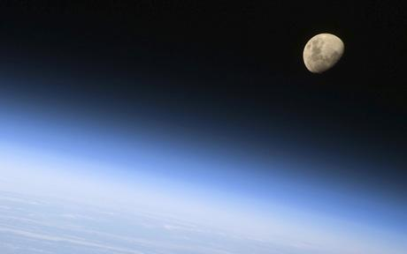
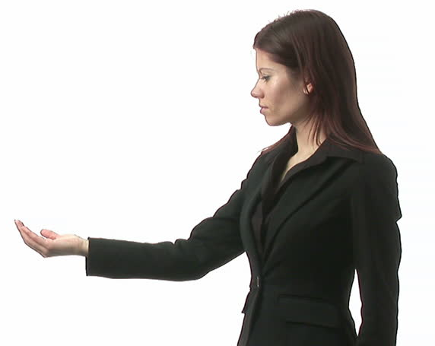
Measuring the Pressure Around Us
Most people do not think about the pressure that results from the gravitational force on the atmosphere above us. At first glance it does not seem to weigh very much when we hold out our hand.
Under what circumstances have you felt changes in the pressure of fluids around you?
Notes:
This laboratory activity will allow students to measure the pressure of fluids using the barometric sensor in their smartphones. An outline of activities include:
Through a short introduction, help students recall familiar situations where they have experienced the effects of fluid pressure and identify how pressure differences are important in our daily activities.
Explore the barometric pressure sensor in smartphones and measure fluid pressure change as a function of altitude in the classroom. Students will explore how best to make the measurement and analyze their results.
Improve measurement accuracy by moving outside the classroom and measuring the pressure change over a greater altitude difference. Students will graph a series of data points collected at progressively higher elevations.
Lead students through an exploration of the sensor’s accuracy and precision. This will be done by comparing measurements made by multiple devices. Use information related to sensor precision—and recognition that atmospheric pressure fluctuations significantly affected the precision of their previous experiments—to design a new experiment to more precisely measure pressure vs altitude. This is a great activity to help students understand the importance of controls in experimental investigations.
Use the precise measurements of pressure vs altitude to calculate the density of air.
Explore the concept of pressure in terms of its definition: force per unit area. Conduct experiments to understand the magnitude of the force per unit area resulting from air.
Conduct experiments under water to explore how pressure changes with depth. Use measurements to calculate the density of water and emphasize the importance of fluid density.
Explore the use of the pressure sensor to explore the pressure variation in different scenarios such as airplanes for cars.

Slide 6
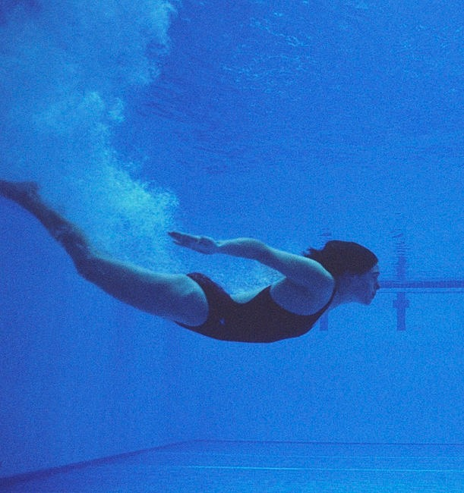
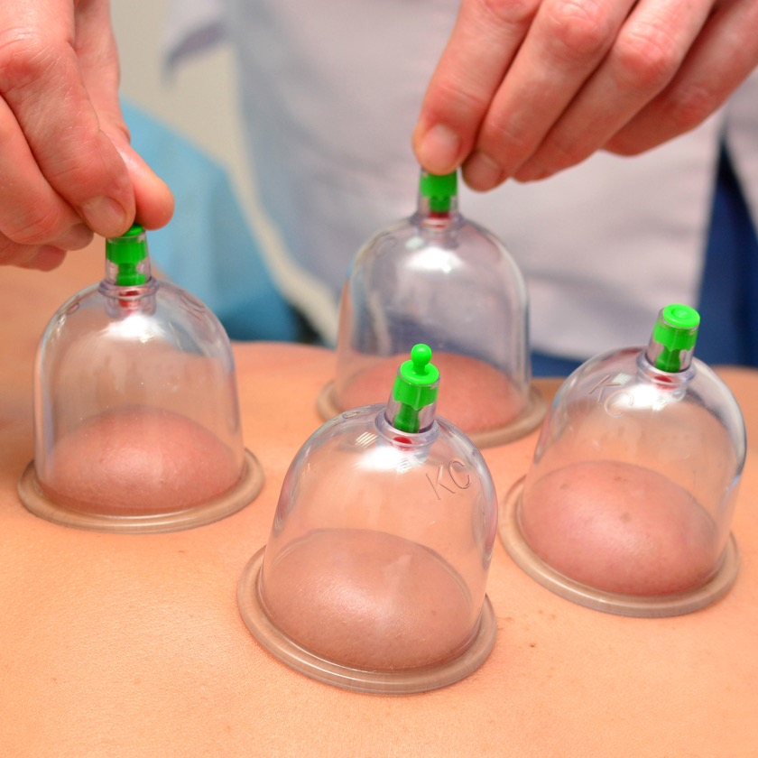
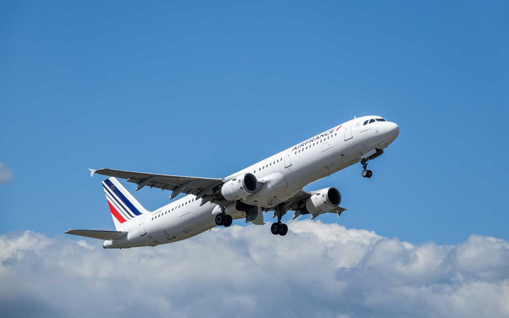
Measuring the Pressure Around Us
Many of us have experienced the effect of pressure changes.
Notes:
Many students will have experienced the effects of pressure changes under water and while on airplanes. Most students are familiar with cupping. Cupping provides a dramatic visualization of how our internal pressure balances atmospheric pressure. In the absence of atmospheric pressure the internal pressure of our bodies pushes against our skin and results in tissue being stretched and more blood flow to the location.

Slide 7
Can you name applications that make use of pressure differences?
Can you think of examples of how nature has evolved to make use of pressure differences?
Notes:
Allow students the opportunity to think about potential applications of pressure differences. Although this experimental activity is focused on fluids, allow students to discuss a wide range of applications that make use of differences in pressure.

Slide 8
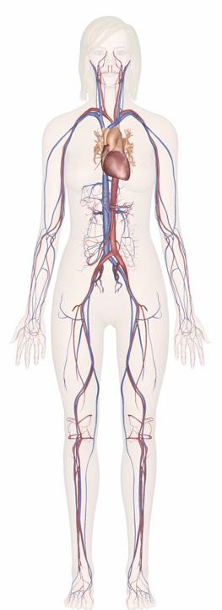
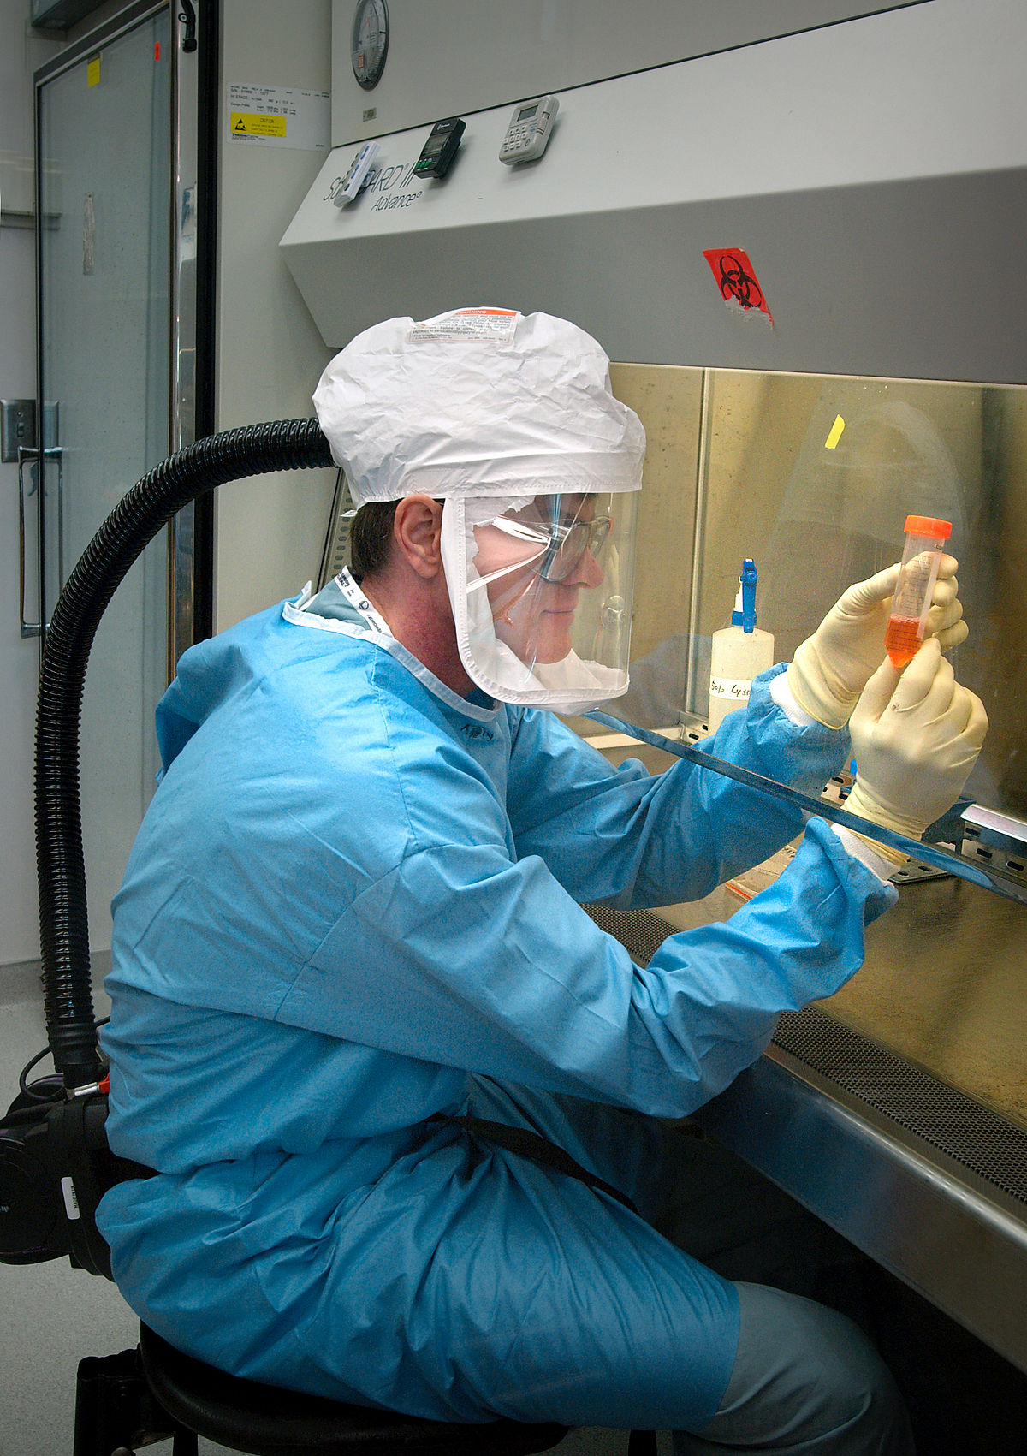
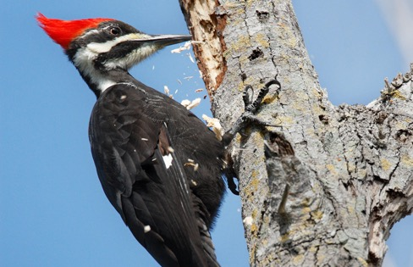
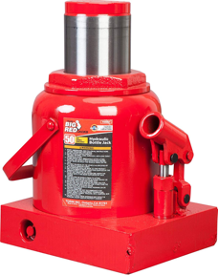
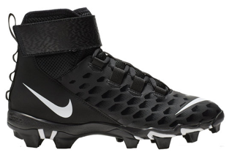
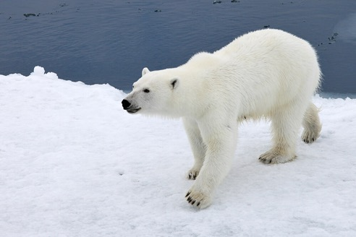
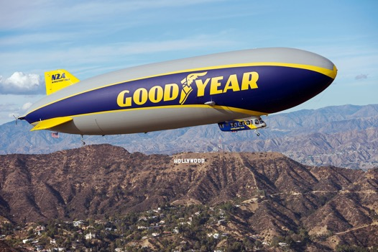

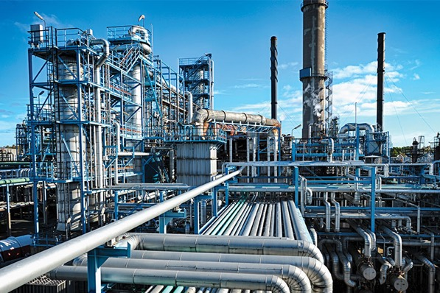
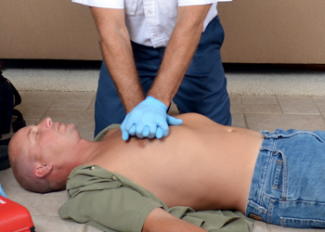
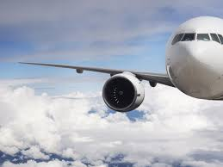
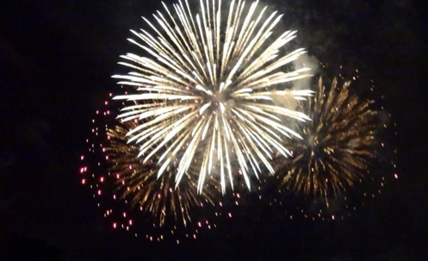
Applications of Pressure Differences
Notes:
This picture may capture some of the student thoughts and may stimulate additional ideas.
Pressure difference in the human body are critical for life. These include the ability to use blood pressure to deliver nutrients and remove waste from locations throughout the body. Pressure difference are also very important at the cellular level and can assist in molecular transport across cell membranes.
Hydraulic pressure is often utilized in machines and robotics.
Many applications depend on transfer of pressure applied by a large surface areas to a small surface area: hydraulic jack, athletic spikes, knife, scrubbing pad, and woodpecker bill are examples.
Biosafety cabinets maintain a higher pressure inside of the cabinets to protect the processes inside the cabinet from contamination.
Large paws enable polar bears to distribute its weight over a large area, allowing the bear to walk on thinner ice.
Creation of low-pressure regions provides buoyancy such as in a blimp or result in directed fluid movement such as in a straw or vacuum cleaner.
Airplane wings create a pressure difference between the top and bottom of the wing, which enables flight.
Combustion processes create high pressures in engines and fireworks.
Chemical plants exemplify use of pressure differences to move fluids for one location to another.
CPR requires the application of pressure to the chest of the patient.

Slide 9
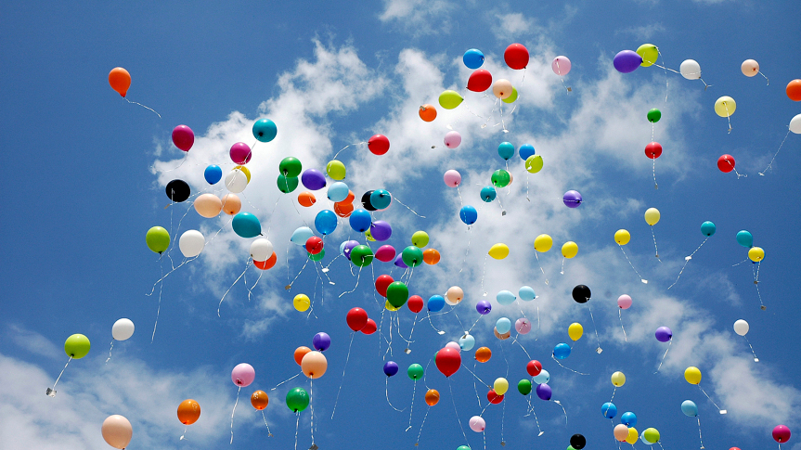
Why Does a Helium Filled Balloon Rise in our Atmosphere?
Notes:
This provides a potential driving question for this activity. Students should write down their ideas before the activity. Some student may state that the balloon rises because helium is lighter than air. However, that is an incomplete answer and students will be in a better position to answer this question using a molecular level models and Newton’s 2nd Law by the end of the experiments. There will be an opportunity to revise their answer after their investigation of pressure.

Slide 10
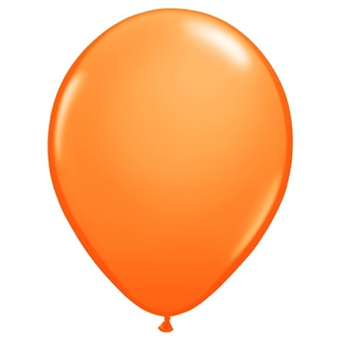
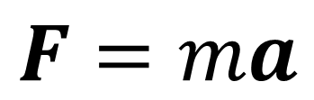
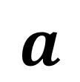
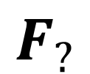
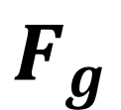
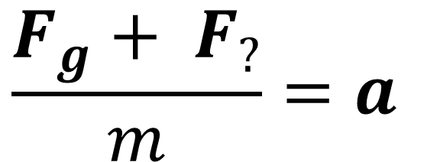
When we let go of a helium filled balloon it accelerates upward away from the earth.
What is causing this force that is greater than the force of gravity on the mass of the balloon and helium inside of it?
$$F_{?}$$
$$a$$
$$\frac{F_{g}+ F_{?}}{m}=a$$
$$F_{g}$$
$$F=ma$$
Notes:
Student should be able to draw a free body diagram for a balloon. They will be able to draw a vector for the force of gravity pulling down a balloon. However, since we observe an acceleration of the balloon in the upward direction, there must be another force in play. Most students will not yet understand the physical phenomena that is causing this force on the balloon. We will be exploring the variation in pressure as a function of altitude in this activity which will provide students with the foundational understanding to determine the origin of what they will learn is a buoyant force.

Slide 11
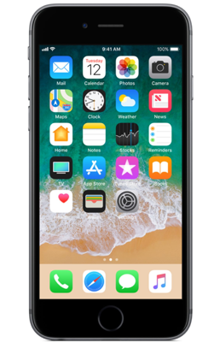
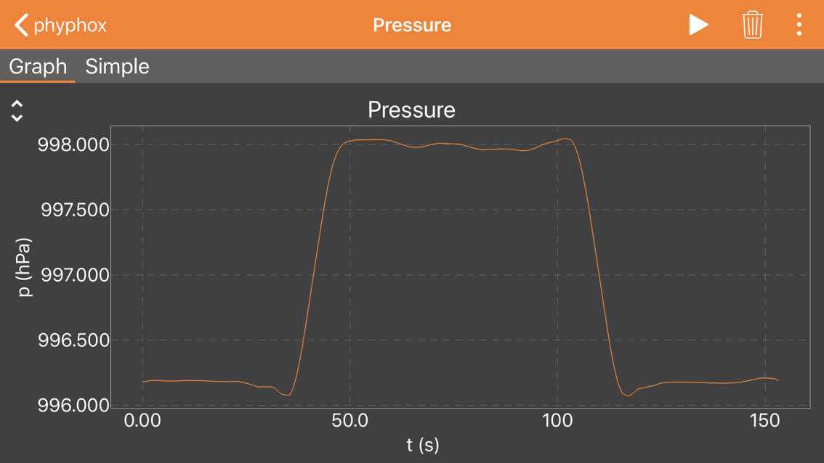
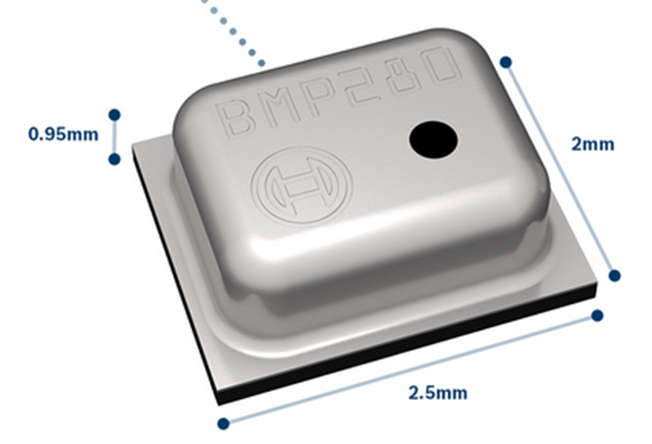
Measuring the Pressure Around Us
Most smartphone contain a pressure sensor that is used for navigation and weather forecasting. We can use the sensor to do very interesting physics experiments!
Bosch BMP280
Barometric Pressure Sensor
Notes:
The sensor shown is an example of one of the sensors used in smartphones. The graphic shows atmospheric pressure change during an elevator ride. The measurement starts on the fifth floor of a building. The elevator starts the decent at ~40 s and goes to the first floor. After waiting on the first floor for about 60 seconds, the sensor returns to the 5th floor.
A description of how the sensor works is at the end of this presentation. The teacher may choose to discuss how the sensor works at the start of this activity.

Slide 12
Initial Exploration
Activity

Slide 13
Initial Activity for Student Exploration:
Measuring Pressure with your Phone
  1) Set you phone on the floor and start measuring pressure.
  2) After 30 second, pick the phone up and put it above you head for another 30 seconds.
  3) Stop data collection and explain your observation.
Notes:
This simple exercise will allow the student to observe that the sensors in their phones are able to measure a significant change in pressure due to a two-meter change in altitude. They will investigate this quantitatively in the experiments that follow.

Slide 14
Example Data

Slide 15
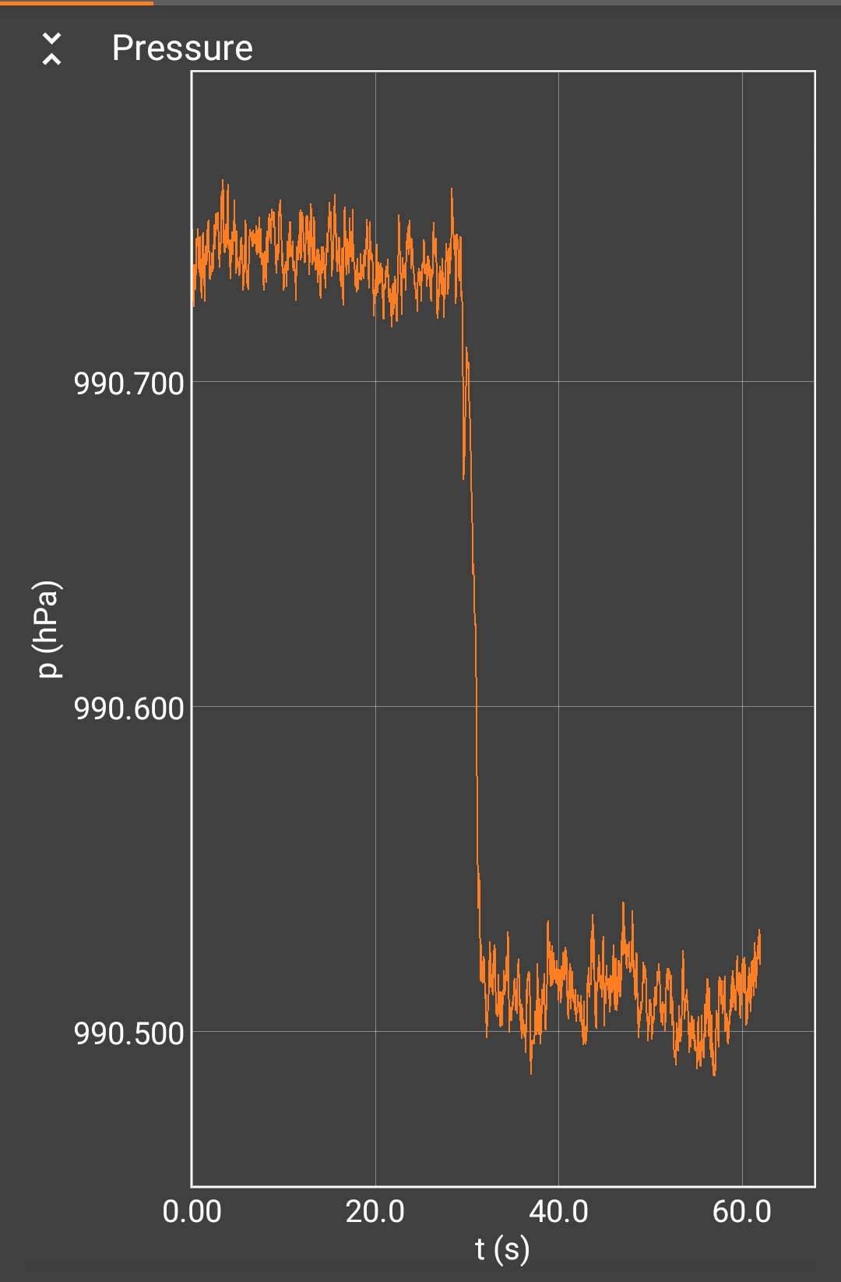
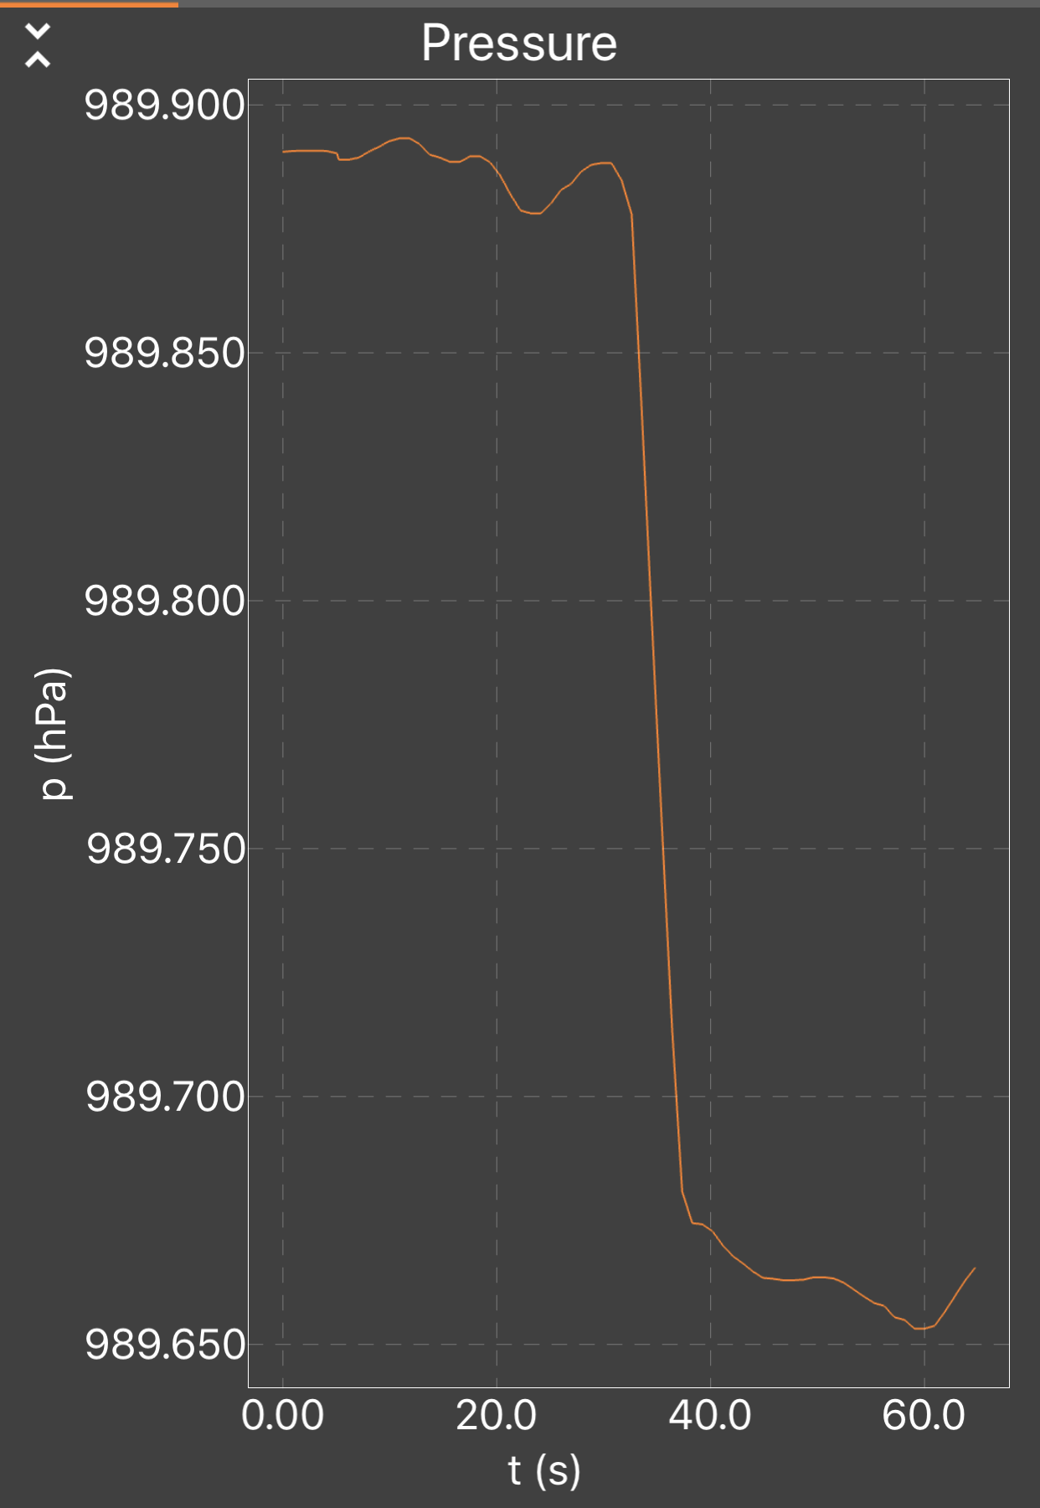
Samsung
iPhone
Notes:
These two screenshots show the change in pressure between the floor and holding the phone at about 2 meters above the floor. The change in data acquisition rate for different phones is also apparent from this data.

Slide 16
Experiment 1

Slide 17
Experiment 1
Measure atmospheric pressure with your smartphone
  Using the pressure senor application in phyphox, measure atmospheric pressure. Report the value in kPa.
  Observe your sensor reading over 60 seconds. Which of the values below best represent the precision of your measurement.
    ~100 Pa
    ~10 Pa
    ~1 Pa
    ~0.1 Pa
  What is the rate at which your phone reports sensor data?
Notes:
This simple exercise will get the student comfortable with the measurement of pressure, the application, and units of pressure. The phone provides data in hPa and this requires students to make sure they can change units.
Step 3 is important since different phones will have different data collection rates and student data may look different. This quick activity will assure students recognize the differences they might observe compared to their classmates. Students should always try to recognize the data collection rate of the instruments they use to make measurements.

Slide 18
Example Data and Calculations

Slide 19
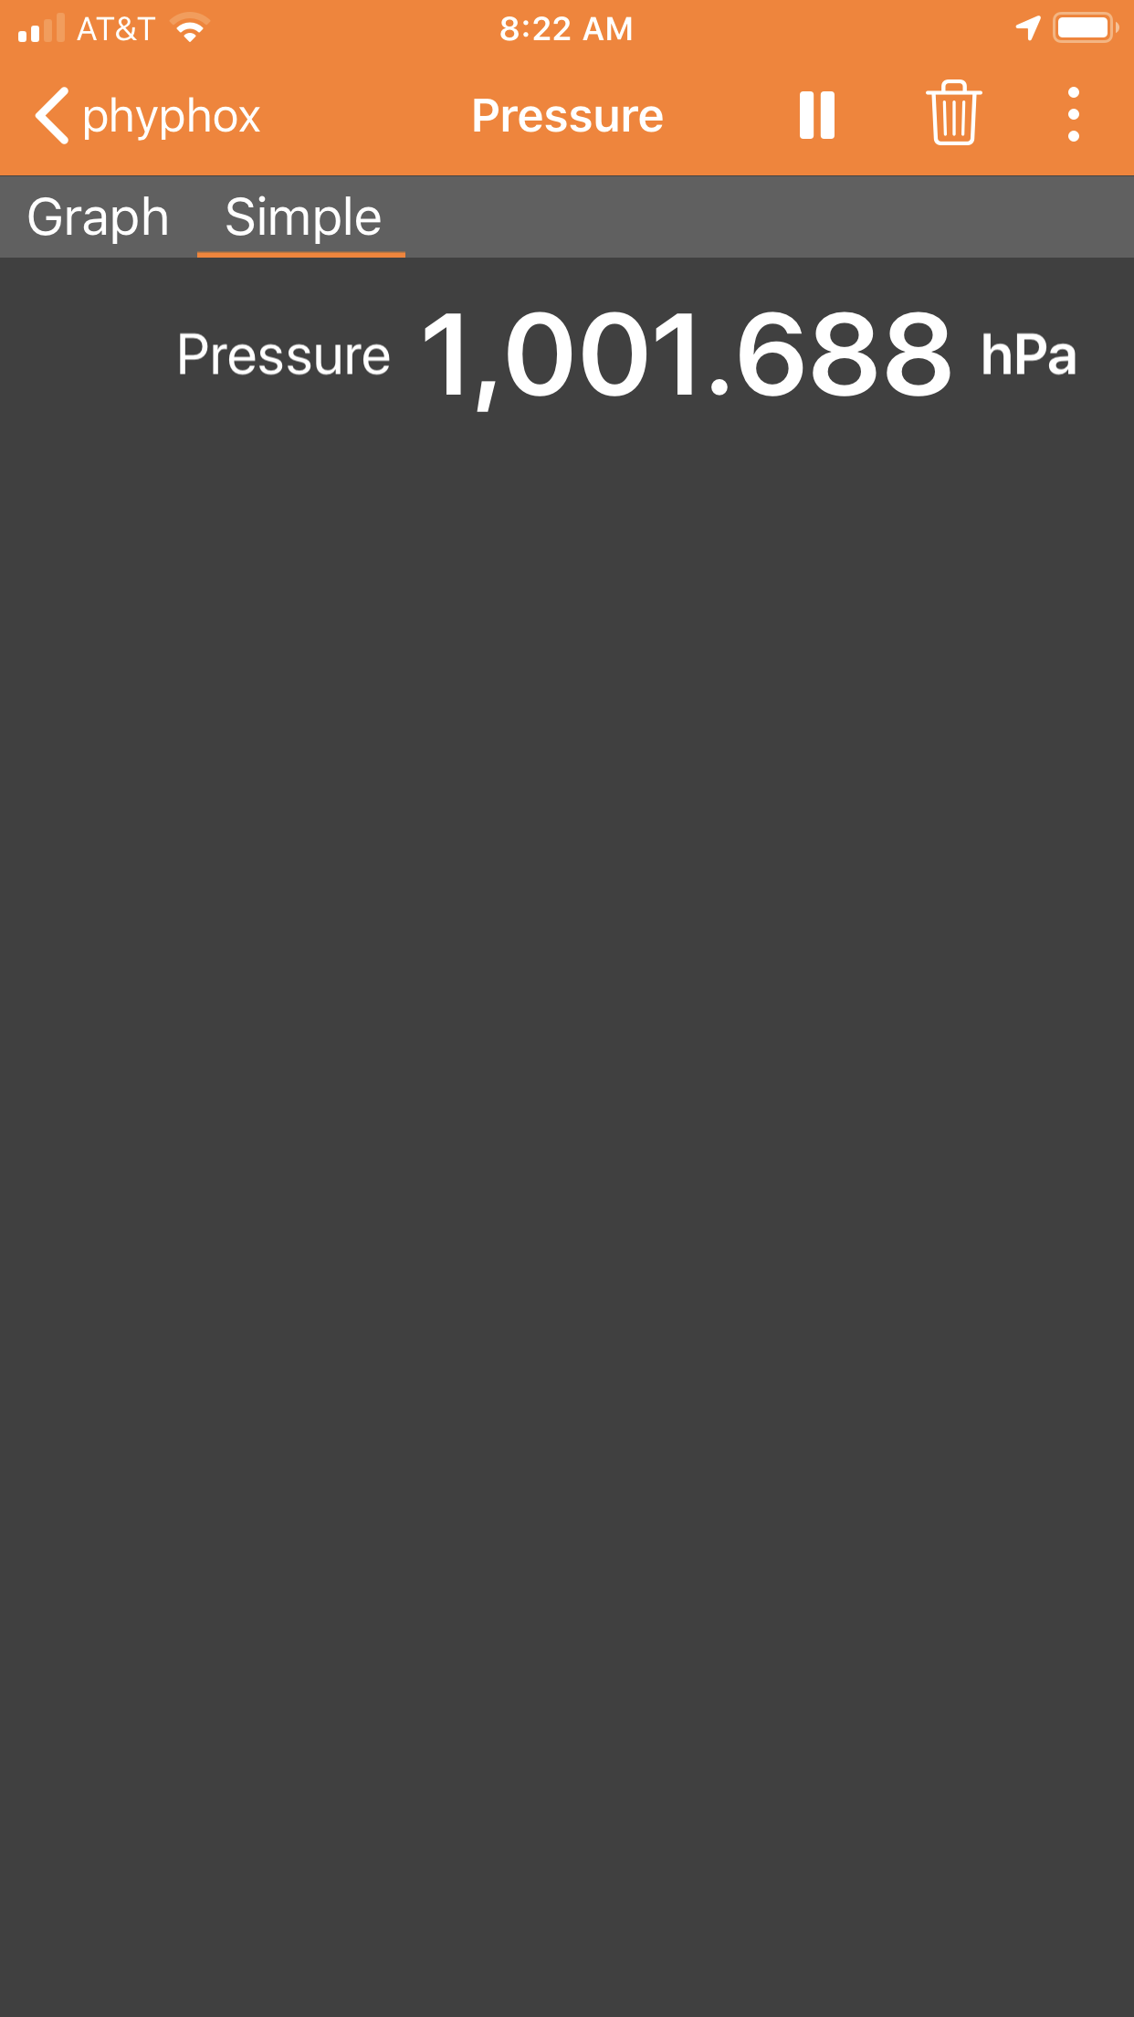
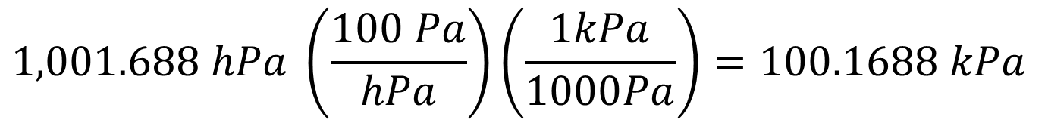
Part 1: Measuring Atmospheric Pressure – Reporting in kPa
$$1,001.688 hPa \left(\frac{100 Pa}{hPa}\right)\left(\frac{1kPa}{1000Pa}\right)=100.1688 kPa$$
Atmospheric Pressure ~ 100 kPa
Or
10,000 Pa
Notes:
This provides students with an opportunity to practice dimensional analysis and reinforce the value of atmospheric pressure.
Students should be able to remember that atmospheric pressure is approximately 100 kPa or 10,000 Pa. This force per unit area is relatively large and is approximately the same as that is generated under the foot of a full-size elephant.

Slide 20
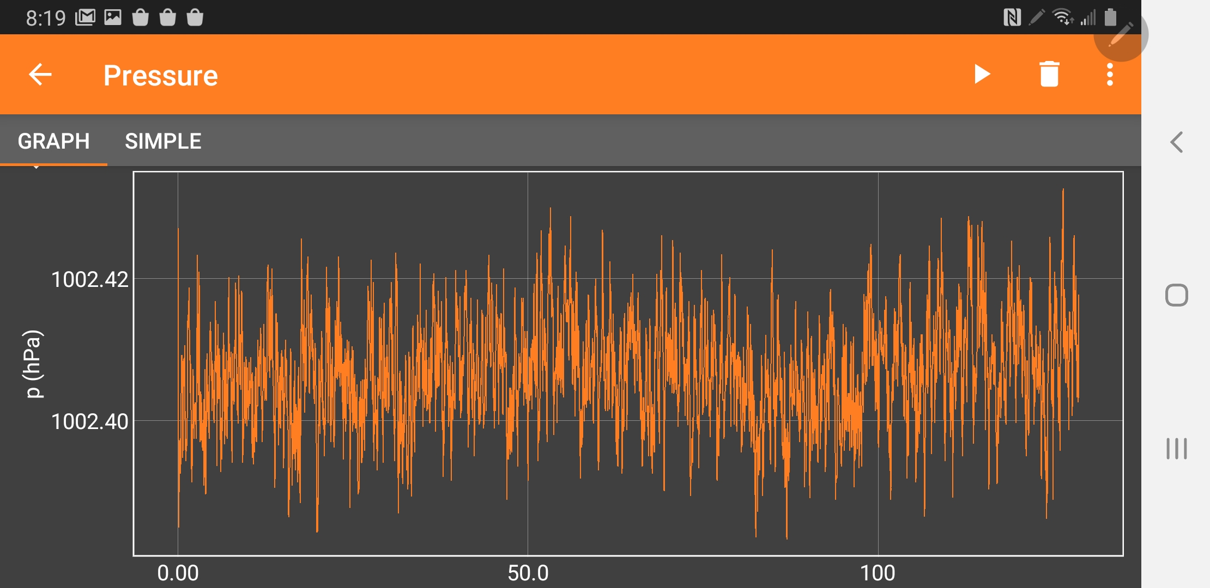
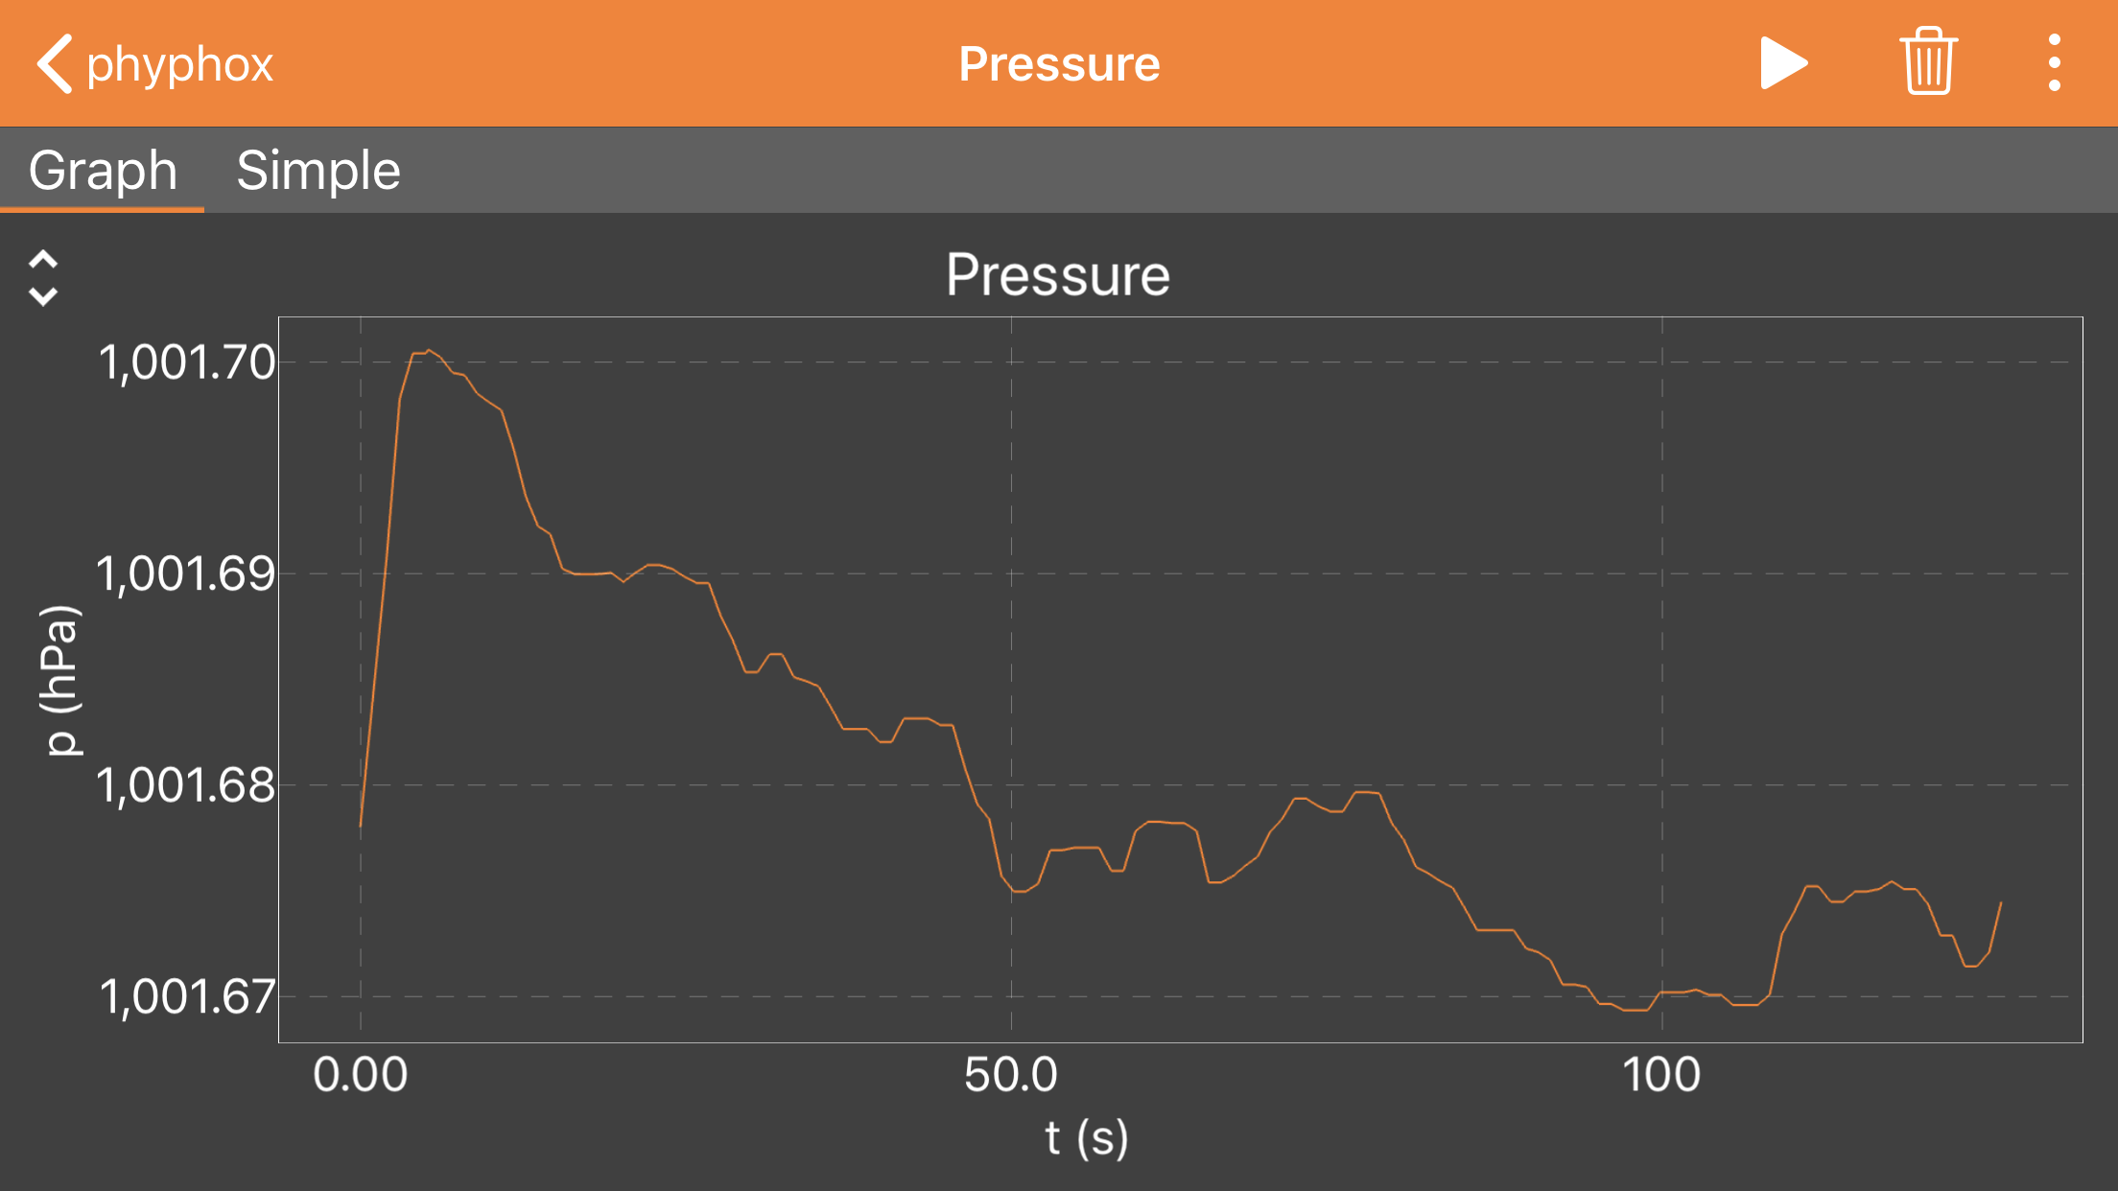
Part 2: Estimating Precision of Sensor Measurement
We can estimate the precision of the pressure measurement to be approximately 2 Pa as indicated by the size of the blue arrows in the figure.
Samsung
iPhone
Minimal Pressure Variation During Measurement
Notes:
Students will see small scale variations on the Samsung phone. The blue arrows represents approximately 1 and 2 Pa on the scale of the graph. This is a reasonable estimate of the precision using a visual averaging.
The precision is more difficult to estimate on the iPhone which does some averaging of the sensor internally and the precision is represented by longer term changes in the pressure. The blue arrow represents 2 Pa in the iPhone figure. It is hard to determine from this graph if the drift observed in the pressure represents the precision of the sensor or a slow change in the atmospheric pressure.
Students might notice that the phones read different values – more on accuracy later.
The pressure in this experiment was recorded inside a closed house during a high-pressure period where atmospheric pressure was relatively constant and there was minimal wind.

Slide 21
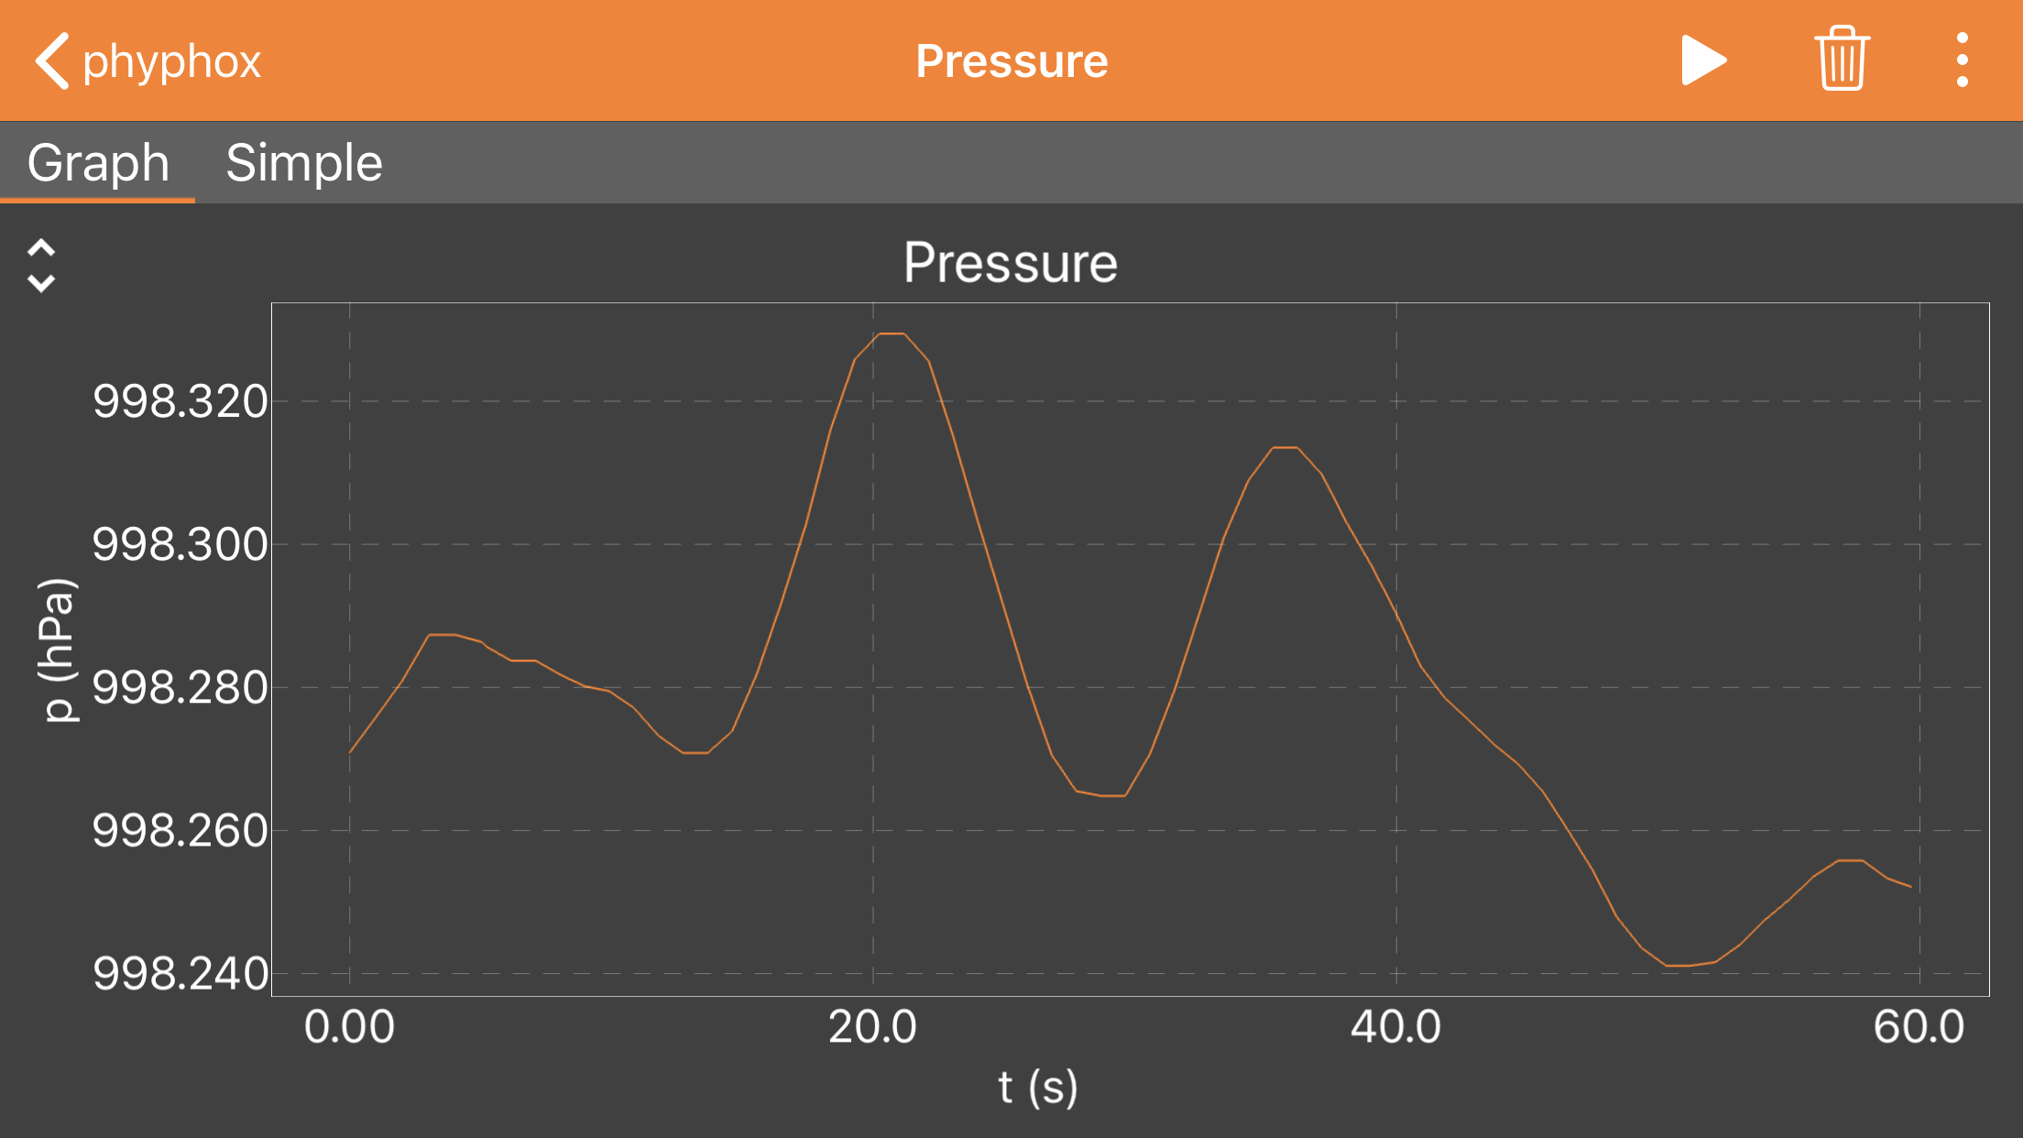
Part 2: Estimating Precision of Sensor Measurement
iPhone
How might you interpret this data?
What is causing the variation in the data?
Sensor noise
Real changes in pressure
iPhone
Notes:
Estimating the precision of the sensor is challenging if there is a real change in pressure taking place.
The next slide, which includes data from two sensors, will help the student recognize that some of the variation is probably real since the pressure variation is correlated between the two measurements.

Slide 22
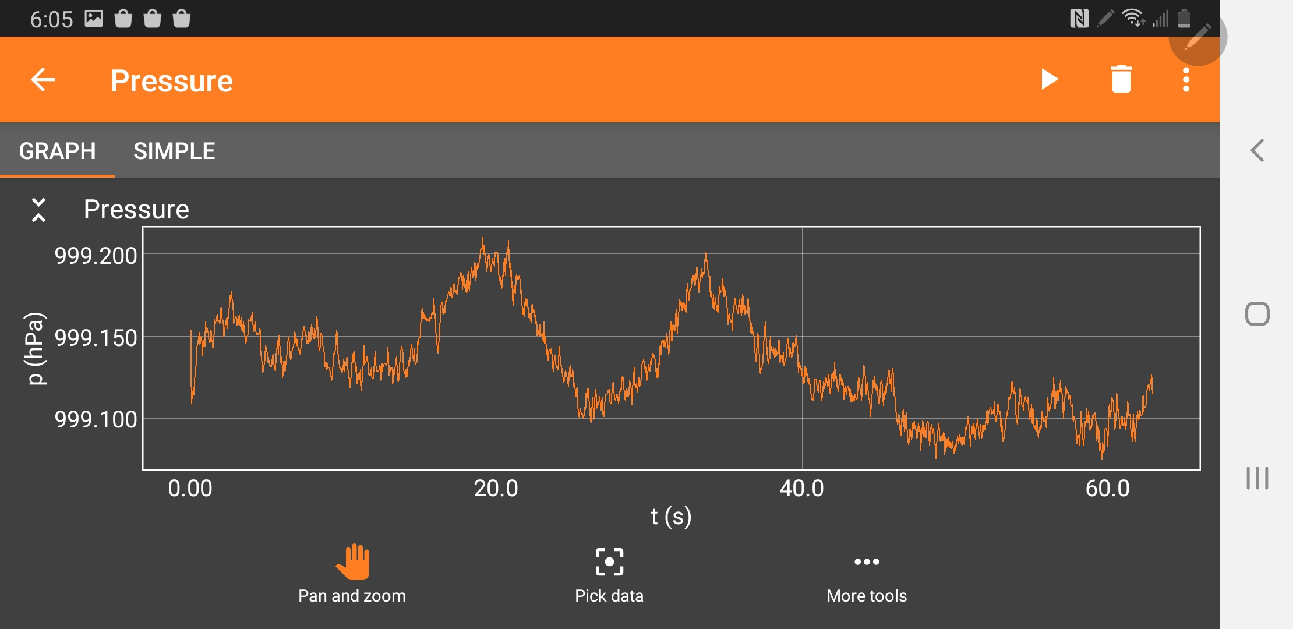
Part 2: Estimating Precision of Sensor Measurement
iPhone
~8 Pa Pressure Variation During Measurement
It is more difficult to estimate the precision of the pressure measurement when there is a real change in pressure during the measurement period.
Samsung
Notes:
Students will see small scale variations that are approximately 1 Pa but will also see longer-term variation that is as much as 8 Pa peak to valley during this period. The observant student will notice that the larger and longer-term variation seems to be correlated on the two devices and therefore may represent real changes in pressure over time. Continued observation would verify the correlation.
It is more difficult to determine the precision of the measurement when the pressure is changing during the experiment. This experiment was conducted in a house during a windy day which resulted in atmospheric pressure fluctuations.

Slide 23
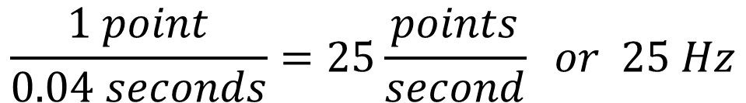
Part 3: Measuring Data Collection Rate
Time (s) | Pressure (hPa)
0.00 | 999.1526
0.04 | 999.1538
0.08 | 999.1086
0.12 | 999.1167
0.16 | 999.1118
0.20 | 999.1184
Date is collected every 0.04 seconds.
iPhone
$$\frac{1 point}{0.04 seconds}=25\frac{points}{second} or 25 Hz$$
Samsung
Notes:
This data collection rate, allows for a range of measurements where students can observe transient changes in pressure on the 0.1 second time frame.

Slide 24
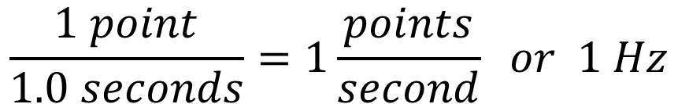
Part 3: Measuring Data Collection Rate
Time (s) | Pressure (hPa)
0 | 998.270721
1.014411 | 998.275757
2.028907 | 998.280869
3.043345 | 998.287277
4.05765 | 998.287277
5.072008 | 998.286285
$$\frac{1 point}{1.0 seconds}=1\frac{points}{second} or 1 Hz$$
iPhone
Notes:
This slower detection rate will limit measurements to changes that take place over a few seconds. Lots of interesting measurements, but does limit potential observations of faster pressure phenomenon.

Slide 25
Experiment 2

Slide 26
Experiment 2
Change in pressure as a function of altitude
  Design an experiment to answer:
  What is your observed change in pressure as a function of altitude?
  Part 1: Two altitudes
  Part 2: Wide range of altitudes
  Calculate the density of air based on your measurements.
Notes:
Part 1) The first goal in this part of the experiment is for the students to recognize that there is a clear measurable decrease in pressure as the sensor is moved from the floor to higher locations in the room. The students should eventually make a few measurements at carefully measured heights to determine the relationship between pressure and altitude. The expected value is ~11.3 Pa/m at sea level and 25 °C (this value has been confirmed by many different scientific measurements historically). Students should be able to make measurements of 11.3 ± 1 Pa/m with a simple two-point measurement over an altitude change of ~1.5 meters.
Part 2) The second measurement might be made between floors of a building, at the top and bottom of athletic stands, or other places suggested by students. This goal is to help students recognize that one potential experimental approach to making a more accurate measurement is to increase the amount of change they are measuring relative to the uncertainty of their measurement device. This can only be achieved if they can maintain accuracy in the measurement of the other variable – height. Multiple measurement points will also help them visualize the accuracy of the measurement by graphing the data and observing a linear fit to the data. Measurements will typically improve to 11.3 ± 0.5 Pa/m. Making measurements at intermediate altitudes will allow the student to see the linear relationship when the data is plotted. If only two points are taken, one would have to assume a linear relationship to analyze the data. While this is true for short distances, if we made measurements over several kilometers, we would find that there is a complex relationship between pressure and altitude that includes a change in temperature.

Slide 27
Experiment 2
Tips
  Identify locations on campus where an experiment could be conducted over a greater range of altitudes. Identify a location where you can achieve the greatest change in altitude as well as make accurate measurements of altitude.
  Consider making measurements of pressure at several intermediate altitudes as well as the minimum and maximum altitudes.
  Graph your data and use a best fit line to determine the relationship between pressure and altitude.
  Compare this measurement with the two-point measurement in step 1 and discuss which value you believe is more accurate. Explain how you reached your conclusion.

Slide 28
Example Data and Calculations
Part 1

Slide 29
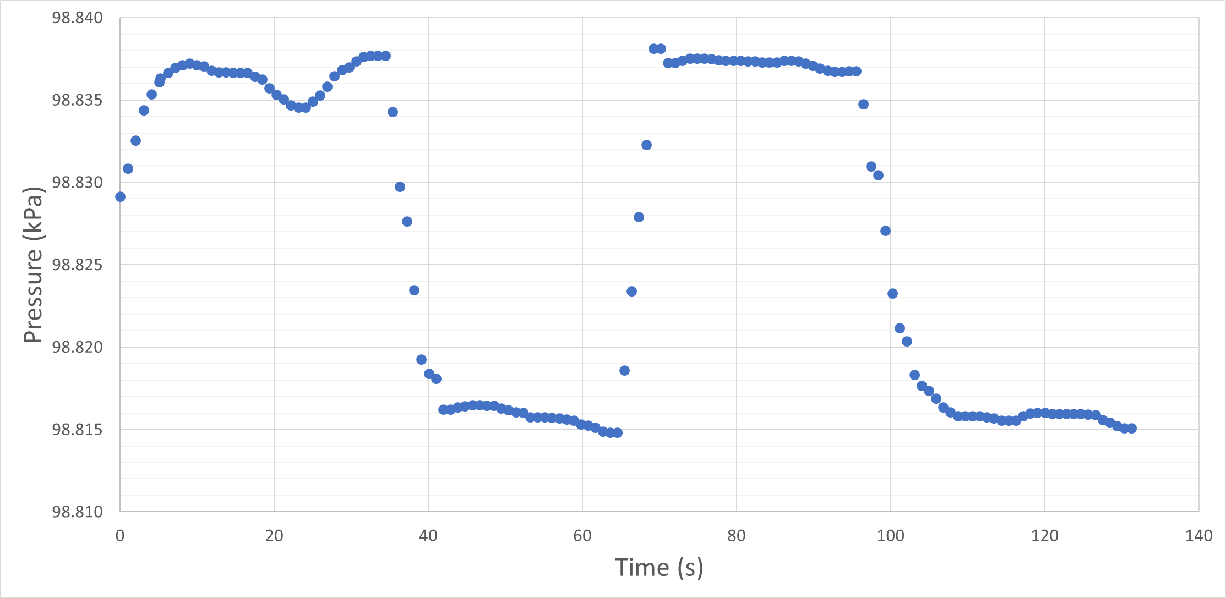

Part 1: Pressure Measured at Two Elevations: Δh = 1.716 m
Floor
20.6 Pa
21.4 Pa
Top of bookshelf
Notes:
Observations that students will make:
The pressure sensor may take a few seconds to stabilize once measurements begins. The first 5 seconds of data should not be considered accurate. This measurement was performed with an iPhone 8; other platforms might have sensors that are more or less capable. The pressure sensor on the newer Samsung phones collect data at faster rates and appear to provide even better measurement precision.
At a single location, there will be small variations in the sensor output. This provides a first indication of the instrument precision. Students will not know if this is due to the sensor precision or actual variations in pressure in the environment.
The sensor may take a few seconds to stabilize at a new measurement locations. Students will find that they will want to allow the sensor to collect data for 10-30 seconds at a location to get an accurate measurement. If the measurements are made over a much longer time period, students will likely observe variations that make their measurements less repeatable. (We will learn later that there are substantial real variations in room pressure.)
Students will quickly see that the sensors are able to measure significant changes in pressure over a distance of a meter and verify that the pressure is measurably higher at the floor (lower elevation).
Using the information from these initial observations, students can then make a set of accurate measurements.
In the example data, the height difference was measured to the nearest millimeter from the floor to the bottom of a bookshelf (note that knowing the exact location of the sensor in the smarthphone/case was not necessary to make this differential measurement as long as the orientation of the phone was maintained). The sensor data at each location was estimated by a visually estimated line through the data and then reading the value from the graph. The average of the differences from the two measurements was used to calculate the value of -12.2 Pa/m. This measurement assumes a linear relationship between pressure and elevation, which turns out to be a very good approximation over short distances. Later examples will show this linearity of the measurements.

Slide 30
Pressure Measured at Two Elevations: Δh = 1.716 m
98.8364 kPa
98.8372 kPa
Graph the four data points and use best fit line to determine slope – next page
98.8158 kPa
98.8158 kPa
Notes:
As an alternative to directly calculating the differences, the estimated values at each altitude can be recorded and graphed. (See the next page.)

Slide 31
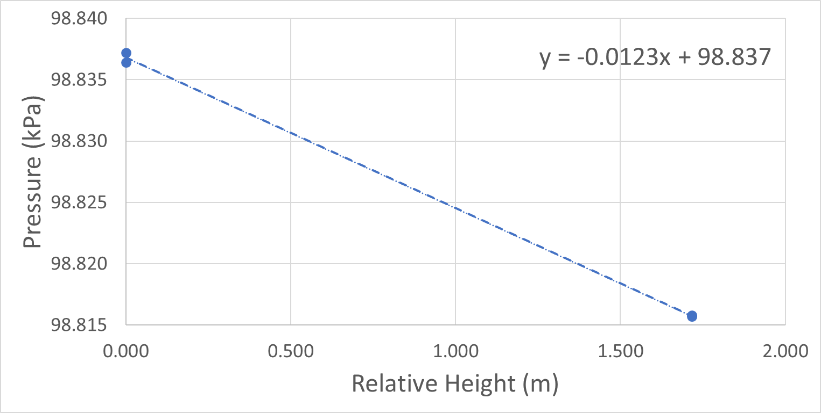

Pressure Measured at Two Elevations: Δh = 1.716 m
Notes:
This graphical method illustrates the value for the change in pressure as a function of altitude. It also provides a visual representation of the variation in data. (note the two data points on the floor, overlap within the precision of the measurement)
Since data was only taken at two height locations, we have made an assumption that the variation in pressure as a function of altitude is a linear function over short distances. We will see from data that is presented later in this activity that this is a good assumption. However, the attentive student should question this assumption until it is demonstrated to be true.

Slide 32
Part 1: Pressure Measured at Multiple Elevations on Bookshelf
0.000 m
0.353 m
0.670 m
0.940 m
1.312 m
Notes:
This is a second experiment done on a bookshelf which allowed measurements at multiple elevations. The benefit of this multipoint data is that it will allow us to see that the function is linear with all the points being represented by a linear function.

Slide 33
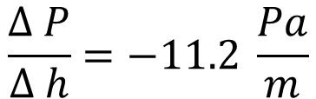
Part 1: Pressure Measured at Multiple Elevations on Bookshelf
$$\frac{∆ P}{∆ h}=−11.2 \frac{Pa}{m}$$
Notes:
The graph provides data points over a range of altitudes. The observation that all the points fall on a straight line, supports our assumption that the relationship between pressure and height is linear for our experimental range. Even thought the individual data points have significant uncertainty, using all the data and determining the slope of the line allows effective averaging over all 5 data points.

Slide 34
Example Data and Calculations
Part 2

Slide 35
Part 2: Measurement of Pressure on Outdoor Staircase
Improved accuracy of “pressure vs altitude” is achieved by measuring over a larger change in altitude.
Floor 2
99.235
Floor 3
99.189
Floor 4
99.144
Floor 5
99.099
Floor 6
99.053
Floor 7
99.008
Notes:
These data were obtained by measuring the pressure at 6 locations in a 7-story building.
The height was determined by measuring the distance of several of the uniform steps and counting the total number of steps for each floor. The differential height for each floor was determined to be 4.10 meters and did not vary between floors.
The pressure measurements were made by starting on the 7th floor. A measurement was made for approximately 70 seconds at each floor before walking down the steps to the next floor. (It is interesting to note that there was a small landing in the middle of each flight of steps and the data shows that small “knee” in the data during each decent.)
The pressure at each altitude is determined by visual inspection of a best fit line and reading the pressure from the graph. (This could also be done by directly averaging the data in the file.)
The temperature and the absolute altitude are noted since both of these parameters will impact the absolute measurement of the pressure and the local air density.

Slide 36

Measurement of Pressure on Outdoor Staircase
Notes:
Graph the data from previous slide. The value of -11.1 Pa/m compares very well with the “expected” average value of -11.3 Pa/m.
Overall, this is a very powerful and accurate measurement of the variation of pressure with altitude in the lower atmosphere.

Slide 37
Example Calculations
Calculation of density of air using pressure vs time data

Slide 38
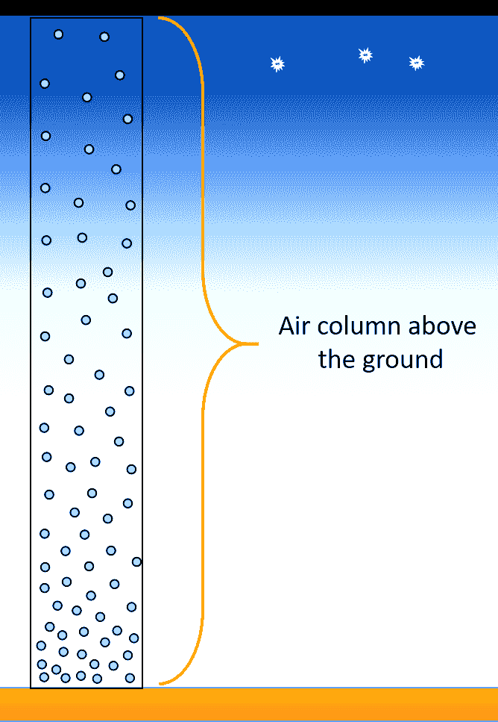
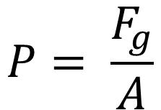



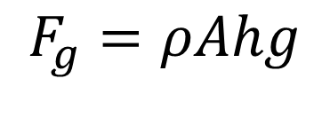
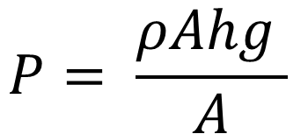
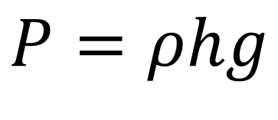
Pressure under a “column” of fluid
P = pressure
F_{g} = force due to gravity
m = mass
g = acceleration due to gravity
ρ = density
V = volume
A = area
h = height
Hydrostatic Pressure Equation
Notes:
This slide shows the derivation of the hydrostatic pressure equation from the basic equation for pressure. We can use this equation and the data from the previous experiment to calculate density. We can use the change in pressure / change in height to solve for the density. (see next page)
Note that the density will change as a function of altitude and temperature. To calculate the pressure over large changes in altitude/temperature would require integration that includes the functional dependence of density on altitude and temperature.

Slide 39
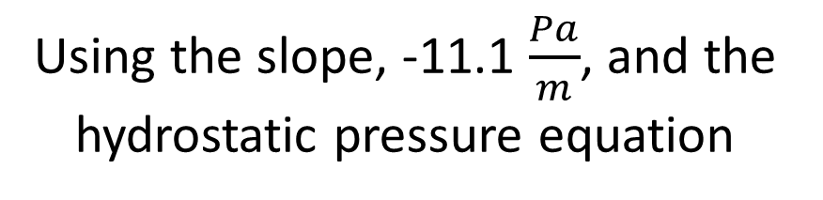
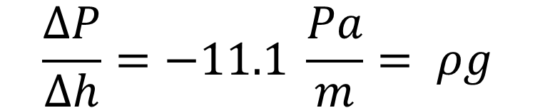
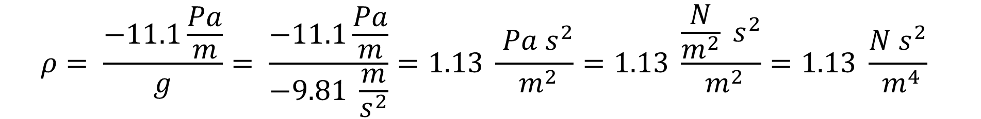
*Note: measurement made at 21°C at base elevation of ~170 m above sea level
Notes:
This slide shows uses the hydrostatic pressure equation to calculate density using the value of -11.1 Pa/m and the acceleration due to gravity 9.81 m/s². It turns out, this is a great exercise for the student to practice dimensional analysis. The steps in the dimensional analysis are shown above.
The density of air is calculated to be 1.13 kg/m³ which is in very good agreement with literature values. The International Standard Atmosphere states air has a density of 1.225 kg/m³ at 101.325 Pa and 15 °C. This measurement was conducted at a slightly higher temperature and pressure so it would be expected to be slightly lower. The student could use the ideal gas law to determine how much different density would be at the measurement conditions from the ISA standard condition.

Slide 40
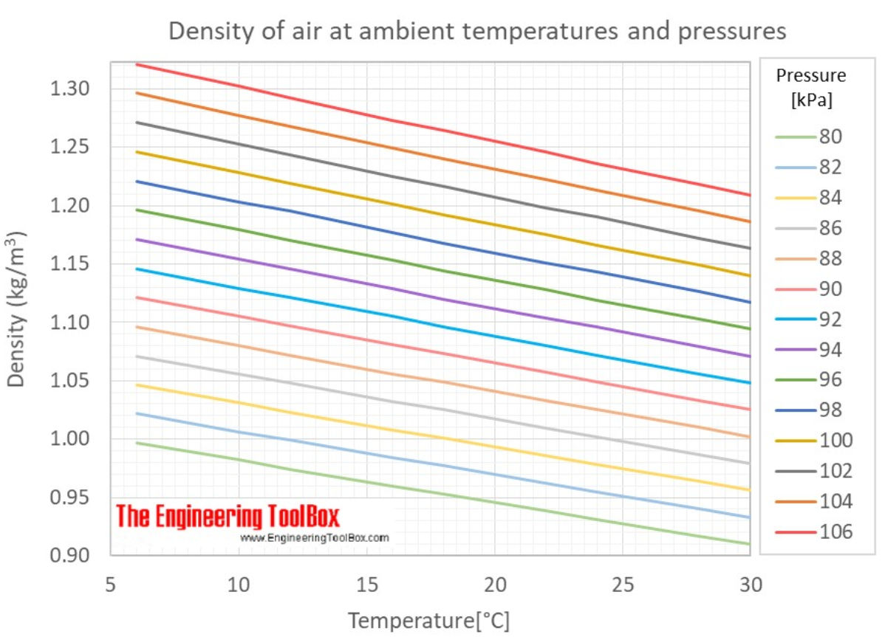
The estimated value from graph : 1.17 kg/m³
Ambient Conditions:
21 °C
99 kPa
The measured value : 1.13 kg/m³
Notes:
A reference graph for density of air vs temperature is shown. The lines on the graph are for different values of pressure. The value of density can be estimated from the graph at our conditions ( 21 C and 99 kPa).
The expected value can be read from the chart above for the conditions of the measurement. In this case there is about a 4% error in the measurement.

Slide 41
Test your Knowledge

Slide 42
A phone was moved between two different altitudes several times
  Was the phone at a higher or lower altitude at t = 15 s or t = 25 s?
  Estimate the height difference between t = 7.8 s and t = 35 s.
Altitude A
Altitude A
Altitude A
Altitude B
Altitude B
Notes:
These data were taken with a Samsung N960U, which collected pressure data at 25 Hz.

Slide 43

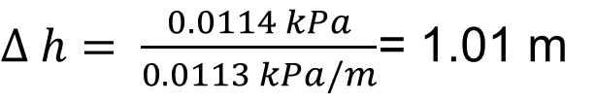

A phone was moved between two different altitudes several times
  Was the phone at a higher or lower altitude at t = 15 s or t = 25 s?
  Estimate the height difference between t = 7.8 s and t = 35 s.
High
High
High
98.9755 kPa
Low
$$\frac{∆ P}{∆ h}=0.0113\frac{kPa}{m}$$
Low
98.9641 kPa
$∆ h= \frac{0.0114 kPa}{0.0113 kPa/m}$= 1.01 m
Notes:
These data were taken with a Samsung N960U, which collected pressure data at 25 Hz. The high data collection rate is very helpful for this type of experiment.
The pressure will decrease with altitude so the height at t = 15 s is higher than at t = 25 s.
The height difference can be measured by determining the pressure difference between the two heights and then using the previously determined value for the change in pressure as a function of altitude. The specific times are not important except to note that they represent the two different heights. Student should recognize that they need to look at the average value of the pressure near a transition and not try to read the value of pressure at the specific time given in the problem. In order to correct for gradual changes in pressure, the difference should be measured by comparing values for pressure close in time to any of the transition points. Only one is shown, but students could use any of the 4 transitions to determine the pressure difference.

Slide 44
Test your Knowledge
Elevator Example

Slide 45
Pressure Change on Elevator
Is the elevator going up or down?

Slide 46
Pressure Change on Elevator
The elevator is going up since the pressure is lower at the final destination.

Slide 47
Pressure Change on Elevator
Estimate the difference in elevation between the initial floor and the final floor.

Slide 48

Pressure Change on Elevator
The change in pressure ~200 Pa.
We determined that that the change in pressure per meter is: 11.1 Pa/m
-$200 Pa \left(\frac{1.00 m}{−11.1 Pa}\right)=18 m$
200 Pa

Slide 49
Pressure Change on Elevator
Estimate the elevator velocity traveling between floors.

Slide 50

Pressure Change on Elevator
Estimate the elevator velocity traveling between floors?
$$\frac{200 Pa}{10 s}\left(\frac{1.0 m}{11.1 Pa}\right)=1.8 m/s$$
10 s

Slide 51
Experiment 3

Slide 52
Experiment 3
Characterize the pressure sensor in your device
  Design an experiment to evaluate the accuracy of the pressure transducers and associated software in smartphones used to measure atmospheric pressure. How can you quantify the accuracy of the sensor?
  Record the pressure reading from the sensor for several minutes.
    How stable is the pressure measurement?
    What are potential sources of the variation in pressure?
  Design an experiment to evaluate the source of the variations you observe in pressure.
    How much of the variation is a result of the sensor precision and how much is due to pressure fluctuations in your environment?
    Design an experiment that would allow the you to determine the precision of the pressure sensor.
Notes:
Step 1: Students will need to work together to get data from multiple devices. The teacher can decide to provide students with the direction to compare sensors in multiple phones or see if students can come up with the idea on their own.
Step 2: Students will observe both short-term and long-term fluctuations in their measurements. Note that the internal software from the phone conducts an averaging of data from the sensor that results in the observed response time of the measurement when the pressure is changed rapidly. The actual sensor has a much more rapid response time.
Step 3 The key to this activity is to get students to make observations on two devices simultaneously over a period of time and discover that a significant part of the fluctuations they have been observing is due to actual pressure fluctuations in the atmosphere. This experiment will require two phones. Using phones that have the same data collection rate will simplify the analysis.

Slide 53
Example Data and Calculations

Slide 54

Part 1: Determining the Accuracy of Pressure Measurements
First calculate the average pressure measured using multiple devices.
Notes:
Six different phones were used to measure pressure at the same time. They included: iPhone 8, iPhone 7, iPhone 6 (3), and Samsung N960U.

Slide 55



Determining the Accuracy of Pressure Measurements
We can express our measurement of pressure as: 99.5735 ± 0.0417 kPa
Notes:
Six different phones were used to measure pressure at the same time. They included: iPhone 8, iPhone 7, iPhone 6 (3), and Samsung N960U.
The average value of pressure and the standard deviation were calculated using the formula on the slide. This provides an opportunity to introduce standard deviation if it is appropriate for the specific class. Otherwise students will be able to describe the accuracy to be four significant figures.
Students might also be able to less formally note that they observed a maximum variation between the highest and lowest measurement of about 0.1 kPa for 6 sensors considered.
There is an opportunity to do an even more in-depth lesson in statistics using all the phones that might be in a classroom.

Slide 56
Part 2: Pressure vs. Time Measurement in Office Building
This variation could be from the precision of the sensor or from real fluctuations in the room pressure.
Notes:
The observations will vary with location, building ventilation system, and the opening and closing of room/building doors. At this point, students may begin to connect the variations with real events and start to recognize that the variation is not just due to the precision of the sensor.

Slide 57

Pressure vs. Time Measurement in Office Building
Pressure data collected using 2 independent sensors
iPhone
iPad
Notes:
Data from two sensors shows a very strong correlation, which demonstrates a major part of the variation they have been observing is due to fluctuations in atmospheric pressure in the building.

Slide 58
Part 3: Pressure vs. Time Measurement in Office Building
The major component of pressure variation is observed by both detectors suggesting that pressure fluctuations are real variations in atmospheric pressure in the office
Notes:
Students are provided a clear demonstration of the great precision of the instrument and the accuracy between devices. The distinction between precision and accuracy is a very powerful concept that is often shown with darts on a bullseye. This experiment provides a powerful demonstration of the concept and its application in making measurements.

Slide 59
Pressure vs. Time Measurement in Office Building - Accuracy
The constant difference between the two pressure measurements provides a measure of the accuracy of the sensors.
Accuracy
0.017 kPa
or
~17 Pa
Students can share data from several phones to determine accuracy.
Notes:
Students are provided a clear demonstration of the great precision of the instrument and the accuracy between devices. The distinction between precision and accuracy is a very powerful concept that is often shown with darts on a bullseye. This experiment provides a powerful demonstration of the concept and its application in making measurements.

Slide 60

Pressure vs. Time Measurement in Office Building - Precision
The absolute pressure measured by the iPhone is compared with the difference in pressure between the iPhone and iPad. The variation of the difference provides a measure of the precision of the pressure sensor.
Notes:
The standard deviation for the difference between the two pressure measurements (precision) was calculated for the 500 data points shown in the figure. This calculation can be done easily using the function for standard deviation in the spreadsheet.
Note that the standard deviation for precision is ~50 x smaller than the standard deviation for the accuracy.

Slide 61


Accuracy vs Precision of Pressure Sensors in Smart Phones
Accuracy:
$$σ=0.0417 kPa$$
Precision:
The precision of the pressure measurement
is ~50 x better than the absolute accuracy.

Slide 62
Experiment 4

Slide 63
Experiment 4
Implementing controls in experimental design to improve measurement precision
  Design an experiment to more accurately measure the pressure change as a function of elevation in your classroom.
  Consider an approach that will allow for corrections to be made for variations of the pressure in the room that take place while you are attempting to isolate the change in pressure as you vary altitude.
Notes:
Experiment 3 introduces the concept of conducting an experiment using a control to remove variations in the data that arise from a variable that is not the target of the experiment. Use of controls is an extremely important concept in experimental science and one that is not easily implemented in a typical high school laboratory experiment.
This experiment will require two phones. Using phones that have the same data collection rate will simplify the analysis.

Slide 64
Example Data and Calculations

Slide 65

Pressure Measurements Using Two Devices
Control Measurement

Slide 66
Pressure Measurements Using Two Devices: Δh = 1.716 m
Device 1
h = 0.00 m
Device 2
h = 0.00 m
h = 1.716 m
Device 1 (“control”) remains on floor while device 2 is moved between two known elevations.
Notes:
Device 1 remains on the floor for the entire experiment.
Device 2 starts on the floor and is moved to a higher elevation for a period of time and then returned to the floor.
The devices should be started at the same time to make the time axes as close to identical as possible.

Slide 67

Pressure Difference for Two Elevations Corrected for Pressure Fluctuations
19.0 Pa

Slide 68
Pressure Difference for Two Elevations Corrected for Pressure Fluctuations
Accuracy of the measurement conducted over a distance of 1.7 m is similar to the measurement that was conducted over 20 m.
19.0 Pa
Notes:
The data from the two devices were transferred to a spreadsheet.
The data was first corrected for absolute differences in pressure from average value of pressure measurements (using data from 10-70 seconds).
Any pressure changes observed by both sensors, such as fluctuations in atmospheric pressure, will not contribute to a differential measurement between sensors.
Changes in pressure that result from the movement of device 2 to a different altitude will produce a differential change in pressure.
The measurement of “pressure vs height” using this “control” method enabled improvement in accuracy. The accuracy of the ~2 meters using the control was similar to the accuracy to the measurement made over 20 meters.

Slide 69
Example Data and Calculations
Second example where background pressure variation is significantly larger and the change in elevation was also larger

Slide 70
Measuring Pressure at Two Different Altitudes: Δh = 3.11 m
Altitude B
Altitude B
Altitude A
Altitude A
Altitude A
Notes:
This is another example of the benefit of using controls to isolate variations from the target variable – in this case we want to measure the change in pressure with altitude but there is significant change in the background atmospheric pressure (weather front moving into local area).

Slide 71
Measuring Pressure at Altitude A
Notes:
The significant change in atmospheric pressure with time is apparent in this data. We see the pressure has changed by as much as 18 Pa – lowest trough to highest peak.

Slide 72
Measuring Pressure at Two Different Altitudes with Control
Notes:
Looking at the pressure measurement form both sensors simultaneously shows a strong correlation in the fluctuations that are not associated with altitude changes.
The data for the control (brown) was corrected (subtracted a constant value to correct for differences in absolute accuracy) to allow it to match up on the scale.

Slide 73

Pressure Variation with Correction from Control Measurement
0.389 hPa
$$\frac{∆ P}{∆ h}= \frac{37.1 Pa}{3.11 m}=11.9\frac{Pa}{m}$$
0.018 hPa
Notes:
That data now looks much more stable once the correction for background pressure fluctuations have been removed by plotting the differences between the two sensor measurements.
The average value for the pressure at the two heights was calculated in a spreadsheet from an average of the data points for each height. The final value is within 10% of the expected value of 11.3 even though there were fluctuations of the background atmospheric pressure that were >30% of the expected change due to altitude changes.

Slide 74
Experiment 5

Slide 75
Experiment 5
Pressure from external forces
  Design an experiment to increase the pressure measured by your smart phone’s barometric pressure sensor by applying an additional external force. (The sensor typically measures the force that results from atmospheric pressure.)
  You will be given a ”ziplock” plastic bag as one potential piece of equipment.
    How much additional pressure were you able to measure?
    How does the additional pressure you were able to generate compare to the pressure that results from the Earth’s atmosphere?
Notes:
The goal of this experiment is to help students get a sense of the force that is being generated by gravity on the air in the atmosphere above their heads.
The following data was collected using a gallon Ziplock freezer bag. This large bag made the experiment easier and was able to withstand larger pressure.
The student does not need to calculate the surface area for this qualitative activity. However, it is possible to make estimates mass if the surface area is estimated.

Slide 76
Example Data and Calculations

Slide 77

Pressure inside of Sealed Plastic Bag
Book Resting on Partially Inflated
1 Gallon Plastic Bag
(Phone inside of Bag)
Notes:
One can use this data to determine the force exerted by the book on the plastic bag. An estimate will need to be made of the surface area.

Slide 78

Pressure inside of Sealed Plastic Bag
Full Scale to Illustrate Change
Book Resting on Partially Inflated
1 Gallon Plastic Bag
(Phone inside of Bag)
Notes:
One can use this data to determine the force exerted by the book on the plastic bag. An estimate will need to be made of the surface area.
This plot shows the very small change in pressure due to the book when the data is plotted full scale.

Slide 79

Experiment:
Increase Pressure by Compression of Plastic Bag Containing Phone
Notes:
A phone was placed in a partially inflated bag. A book was set on the bag. A person then balanced on the book. The resulting change in pressure is shown on the next page.

Slide 80
Increase in Pressure Resulting from the Weight of a Person Relative to the Pressure that Results from the Weight of the Atmosphere
118.3 kPa
Experiment
iPhone placed in partially inflated 1 gal plastic bag (dimension of 27 cm x 27 cm)
Ridged book on plastic bag (dimensions of 21 cm x 28 cm)
Person with a mass of 115 kg stands on book
Pressure resulting from 115 kg person
98.8 kPa
Δ P = 19.5 kPa
Pressure resulting from Earth’s atmosphere
Notes:
Many potential experiments could be designed by students to demonstrate this concept. This graph shows that the weight of a large person is only a fraction of the weight produced by the air above them. Given their understanding of density, they get a sense of how far up the atmosphere extends and the impact of gravity on the molecules in air.

Slide 81
Additional Ideas for Teachers

Slide 82
Additional Ideas for Understanding Force per Unit Area
Consider using a much larger surface area to help students understand the inverse relationship between pressure and surface area for a constant force. One option could be a person laying on an inflated garbage bag containing a phone measuring pressure under remote access.
  This concept could be presented as a challenge problem to the class and a competition could be introduced to see which group of students can support a classmate's weight with the smallest increase in pressure. They will need to find the person with the least mass and support it with the largest area.
Another idea is to have students explore other situations where pressure changes might be measured. This might include exploring the pressure in cars which is shown the next few slides.
Notes:
The expectation is that by distributing the student’s weight over a large surface area, the observed pressure should be substantially lower than in the case of the ziplock bag where there is a large force per unit area.

Slide 83
Variation of Pressure inside of Car
6
6
Fan Setting: 1-6
Windows Shut
5
5
4
4
3
3
2
2
1
1
Window Open
Notes:
The data collection rate is 25 Hz. This data shows how the pressure in a car increases as a function of the fan speed. It might be interesting to have students compare the relative pressure differences that can be achieved in different types of cars and develop potential explanations for what they observe.
It is impressive to see how quickly the pressure equalizes with the outside as soon as a window is opened. Students could relate this to the speed of sound as a pressure fluctuation is propagated from one location to another.
This is a great demonstration of Pascal’s Law: a change in the pressure applied to a fluid is transmitted undiminished to every point of the fluid and to the walls of the container. Just a small crack of the window, equalizes the pressure of the entire volume of air in the car.

Slide 84


Variation of Pressure inside of Car While Passing Cars Driving in Opposite Direction
Notes:
The high-pressure region in front of a moving car and the low-pressure region behind a car can be detected by a car traveling in the opposite direction. The windows of the car were closed during this experiment.
The data collection rate is 25 Hz.
Students could explore the pressure difference as a car passes in different ways: standing by passing car, observing the difference with windows open, etc.…

Slide 85
Test your Knowledge

Slide 86
The data on the next slide shows pressure data taken inside a commercial jet flying from San Francisco to Washington DC.
Answer the following questions:
Using the internet, find the typical pressure and temperature outside a commercial jet at cruising altitude.
What altitude does it ”feel like” in the cabin of the plane?
What are some of the engineering and health related considerations that might go into determining the pressure that is maintained in the cabin and the rate at which that pressure change takes place?

Slide 87
Pressure inside the Cabin of Commercial Jet Traveling From San Francisco
Taxing on Runway
Take-off
Cruising Altitude
Notes:
Average cruising altitudes are 11,000-12,200 m. At 12,000 m, the pressure is approximately 19 kPa and the temperature is -57 C.

Slide 88

Pressure inside the Cabin of Commercial Jet
Taxing on Runway
Take-off
20,100 Pa
Cruising Altitude
Notes:
Average cruising altitudes are 11,000-12,200 m. At 12,000 m, the pressure is approximately 19 kPa and the temperature is -57 C.
Because San Francisco is close to sea level, the difference in pressure between take-off and cruising altitude can be used to calculate the altitude that would correspond to the pressure in the cabin. The result is on the order of 1800 meters
At higher altitudes, the oxygen taken up by the blood is less and the gases within the body expands. Pressures of ~80 kPa, contain ample oxygen for the health of passengers. Significantly lower pressure would lead to discomfort for some passengers. The pressure range in cabins is regulated by the Federal Aviation Administration. See https://www.who.int/ith/mode_of_travel/cab/en/ for more information.
At cruising altitude, the pressure is significantly lower outside the aircraft and lowering the differential is beneficial to the structural integrity of the fuselage.

Slide 89
Experiment 6

Slide 90
Experiment 6
Measuring pressure as a function of depth underwater
  Design an experiment to measure the pressure as a function of depth under water. Be very careful to protect your device from getting wet.
    Report the value in Pa/m and compare to air.
    Calculate the density of water from your measurements and compare to expected values.
Notes:
The goal of this experiment is to help students understand the much greater pressure produced by dense fluids.

Slide 91
Example Data and Calculations

Slide 92
Fluid Pressure in Water
Sensor being lowered into pool in
20-centimeter steps.
Sensor being raised out of pool in
20-centimeter steps.
Notes:
The phone was placed in a Ziplock bag inside another Ziplock bag to protect it from water. It was then secured to a board so that the x-y plane of the phone was parallel to the water surface. The phone was lowered into the water in 20-centimeter steps and held at each location for approximately 10 seconds. A yardstick was also secured to the board to measure the phone’s depth below the surface of the water.

Slide 93

Fluid Pressure in Water
Δd = 20.0 cm
Δp = 1.95 kPa
Δd = 20.0 cm
Δp = 1.95 kPa
Δp = 1.94 kPa
*Note: measurement made at 26°C
Notes:
The differential pressure data was determined from the average value of the pressure at each depth. The absolute depth of the first measurement was not considered accurate due to the difficulty in taking a measurement at the first 20 centimeter depth below the surface. Measurements made at 20 cm increases in depth for the last three depths were used in the calculations. Very accurate values can be gathered from the data files directly or by zooming in on the graphical data.

Slide 94




*Note: measurement made at 26°C
Notes:
This value is very accurate as compared to the accepted value at 25 °C of 997 kg/m³. (See the next page.)

Slide 95

Density of Water from Engineering Tables

Slide 96




Relative Densities of Water and Air
Cubic meter
Temperature= 0 °C Pressure = 101.3 kPa
Notes:
This result provides students a sense of the relative densities of gases and liquids. Liquids are on order of a 1000 x more dense than gases at standard conditions.

Slide 97
Pressure in our Lives
Further applications

Slide 98
Why Does a Helium Filled Balloon Rise in our Atmosphere?
Notes:
We are now ready to answer this question.

Slide 99




The Buoyancy Force
$$F_{top}=P_{top}A$$
Increasing Pressure
$$F_{bouyancy}=F_{Top}−F_{Bottom}$$
$$F_{bottom}=P_{bottom}A$$
Notes:
Our experiments just demonstrated that the pressure of Earth’s atmosphere increases as the altitude decreases. This will result in a slightly larger pressure (force per unit area) on the bottom of an object relative to the top of the object. We call this difference in force, the buoyancy force.
The conceptual model for this is that at lower elevations where the density of the fluid is greater, there are more collisions of molecules taking place. The collective sum of the forces from each molecular collision is what causes the pressure we measure. Since more collisions are taking place at the bottom of the object than the top, there is a net force from the atmospheric fluid on the object.

Slide 100



Why a Helium Filled Balloon Rises
$$F_{bouyancy}$$
When,
Increasing Pressure
$$F_{bouyancy}>F_{gravity}$$
the balloon will rise
$$F_{gravity}$$
Notes:
If the buoyancy force is greater than the force of gravity on the object, the object will rise. A helium filled balloon rises because the low mass of helium results in a lower force of gravity on the object. In the case of a helium balloon in Earth’s atmosphere, the buoyancy force is greater than the gravitational force, so the balloon rises. Of course if the helium was put in a heavy metal container, we would not expect the container to rise as the gravitational force on the container filled with helium would likely be larger than the buoyancy force. This changes when the surrounding fluid has a greater density, like water. We observe this large buoyant force when we see massive steel boats floating in the ocean.

Slide 101




Buoyancy Forces
Notes:
Students can see the results buoyancy forces all around them. This sets the experimental foundation for discussion and derivation of Archimedes’s principle.

Slide 102
Inside the Sensor
How Does it Work?

Slide 103
Additional Information of Bosch BMP280 Sensor
Sensor Specifications
  Compare specifications for accuracy and precision with your
  experimental results.
Piezoresistive Effect and Sensor Design
Scanning Electron Microscope Image of Sensor
Notes:
Depending on the class and teacher perspective, it might valuable to have a description of how the sensor works at the start.

Slide 104

Specifications for the
Bosch BMP280
Notes:
The specification for absolute accuracy is stated to be 100 Pa.

Slide 105

Piezoresistive Effect
Some materials will change their ability to conduct electricity (i.e., resistance) when they are put under stress such as bending.
The sensor in our phones makes use of a small silicon “wire” that is placed on a flexible membrane.
When pressure flexes the shape of the membrane and hence the wire, the resistance of the wire changes.
This change in resistance can be used to measure the pressure.

Slide 106

Scanning Electron Microscope Image of the
BMP280 Sensor use in an iPhone

Slide 107
A few fun video clips that demonstrate interesting effects of high and low pressure.

Slide 108

Notes:
At 2.5 atmosphere of external air pressure, the dissolved carbon dioxide is not driven out of solution as we are expecting from our experience at 1 atmosphere of external pressure.
https://youtu.be/EJiUWBiM8HE

Slide 109

Notes:
This is a more dramatic version of the traditional can crushing demonstration using the force of atmospheric pressure to crush a railroad car container that has a low internal pressure.
https://youtu.be/UpWeU2fvFGs

Slide 110

Let Me
Know
I welcome any feedback on errors you might find or ideas on how to improve this for students and teachers.
Prepared by:
David Rakestraw
Senior Scientist
Lawrence Livermore National Laboratory
rakestraw1@llnl.gov • 925-216-8106 • st.llnl.gov

Slide 111

This work was performed under the auspices of the U.S. Department of Energy by Lawrence Livermore National Laboratory under Contract DE-AC52-07NA27344.

