Slide 1
FRICTION
Exploring Friction and Mechanics
Notes:
LLNL-PRES-761938

Slide 2

Friction
Notes:
All physics student have heard the phrase “ignoring friction” or “consider a frictionless surface” when working problems. This simplification is useful to allow students to understand certain concepts.
Lucky for this guy, there is friction in most real-world scenarios. This lesson/activity is intended to help better understand the importance of friction and learn how to measure it.

Slide 3
Exploring Friction and Mechanics
Unifying Concepts
Module Systems
Applications:
Making it Real
Newton’s Second Law
F=ma
Free-body Diagrams
Elastic Force
Frictional Force
Normal Force
Energy Conversion
Kinetic Friction
Static Friction
Tires and the Environment
Measuring Acceleration
Experimental Design
Human Joints and Artificial Joint Replacements
Analysis of Forces during Energy Conversion Processes
Free-body Diagrams
Calculation of Velocity and Displacement
Analysis of Forces and Acceleration
Motion with Constant Acceleration
Graphical Analysis
Lubrication and Environmental Impacts of Energy Loss from Friction
Problem Solving
Coefficient of Friction
Kinetic Friction
Static Friction
Comparison of Static and Kinetic Friction
Coefficient of Kinetic Friction and Dependence on:
Mass
Surface Area
Surface Properties
Geographical Fault Lines and Earthquakes
Conceptual Module for Macroscopic and Microscopic Frictional Forces
Notes:
Outline of the unifying concepts, activities and applications that will be covered in this unit on friction and mechanics.
Much of this unit will focus on using a very simple experimental design to measure the coefficient of kinetic and static friction. In the process, the activity provides for a very rich investigation into the core disciplinary ideas in mechanics.

Slide 4
Exploring Friction and Mechanics - Unit Overview
Unifying Concepts
Experiments
Applications and extensions
  Newton’s 2nd Law
  Principles of mechanics
  - Free-body diagrams
  - Forces
  - Acceleration
  - Velocity
  - Displacement
  Energy Conversion
  Motion with constant acceleration
  Coefficient of static and kinetic friction
  Conceptual models for friction at microscopic and macroscopic dimensions
  Experiment 1: Measuring kinetic friction and exploring relationships in mechanics
  Experiment 2: Measuring the relationship between mass and the coefficient of friction
  Experiment 3: Investigating effect of surface properties on kinetic friction
  Experiment 4: Measuring static friction
  Experiment 5: Exploring experimental designs to measure friction
  Tires and the environment
  Human joints and artificial joint replacements
  Lubrication and environmental impacts of energy loss from friction
  Geographical fault lines and earthquakes
Notes:
This table provides an outline of the unifying concepts, experiments and applications that will be covered in this set of activities.
Much of this unit will focus on using a very simple experimental design to measure the coefficient of kinetic and static friction. In the process, the activity provides for a very rich investigation into the core disciplinary ideas in mechanics.

Slide 5
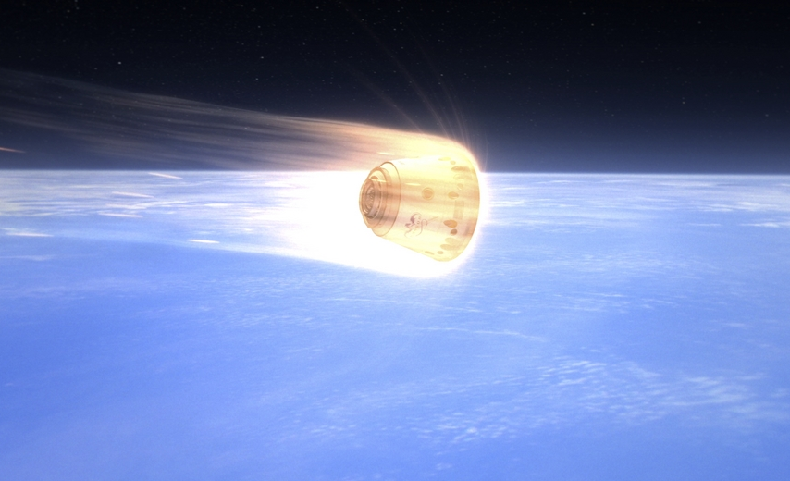

What is Friction?
Friction is the force resisting the relative motion of objects sliding against each other.
F_{friction}
Notes:
Friction can take place between solids, liquids and gasses. The force from friction can be understood from our own experience pushing objects along the floor or putting our hand out the window of a moving car. In both cases we feel a force “resisting our motion” – this is a frictional force. Many of us have seen the effect of friction when we watch a spacecraft reentering the Earth’s atmosphere where it slows down due to collisions with the molecules in the atmosphere and heats up as kinetic energy is converted to thermal energy.
The frictional force on an object is in the opposite direction from the direction the object is moving or trying to move.

Slide 6
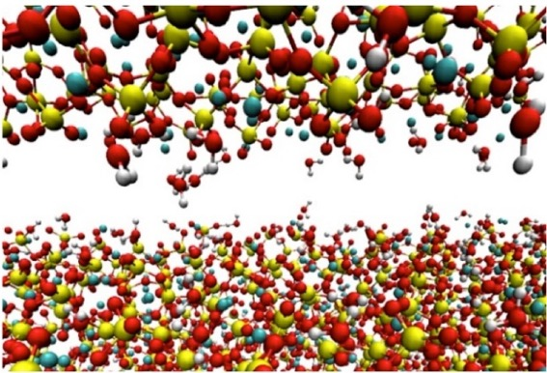
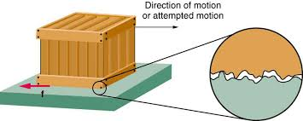
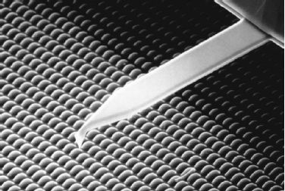
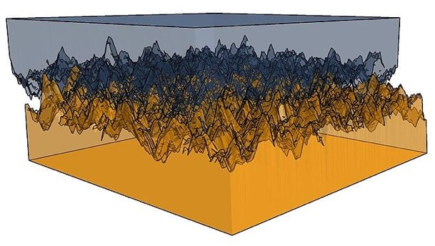
What Causes Friction?
There are a combination of macroscopic (surface roughness)
and microscope (molecular level forces) that contribute to friction.
Atomic Force Microscopy
Notes:
This slide is intended to help students appreciate the complexities of friction and to allow the teacher to explain that many of the details are still not fully understood. Understanding friction is still a very active area of research.
Generally we know:
Some aspects of friction can be explained from looking at the macroscopic roughness of the two surfaces.
Some aspects of friction can be explained from the molecular level forces. Sometimes very smooth surfaces can result in large frictional forces as a result of molecular level interactions between the two surfaces (resulting from electromagnetic forces).
The atomic force microscope uses a very fine tip (often a few molecules) to measure the attraction to a surface as the tip is “scanned” over the surface. The atomic force microscope enables a very detailed understanding of surface properties and frictional forces. (An experiment in the harmonic oscillator unit provides an opportunity to further explore the principles of operation of an atomic force microscope.)

Slide 7
Friction in our Lives
Introduction

Slide 8

Friction: Both Good or Bad
Where do we use friction to our benefit?
Notes:
The next few slides are intended to help students think about how important friction is to the world around us.
Allow students to share their experiences where friction is beneficial.

Slide 9
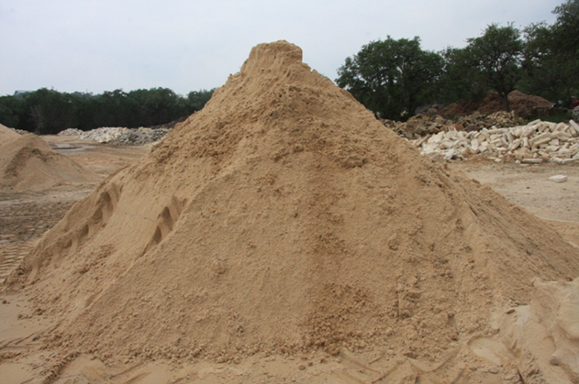
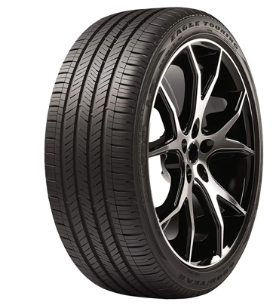

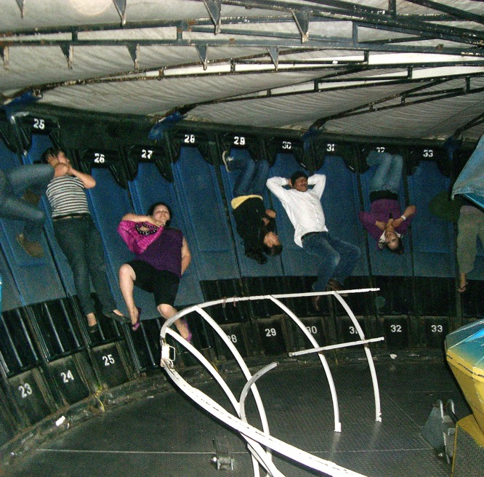
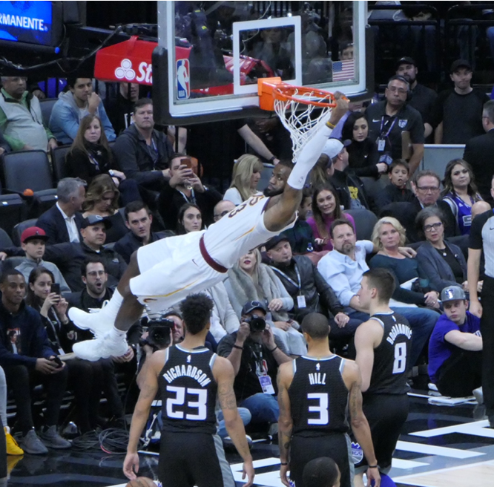
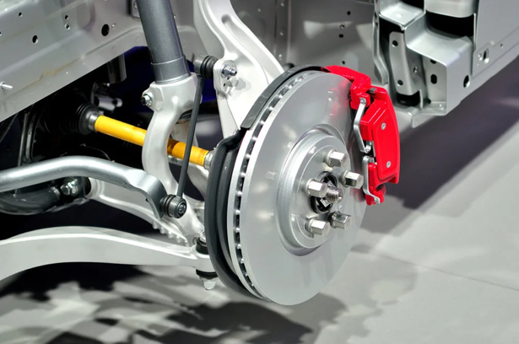
Friction
is
GOOD!
Notes:
These are just a few pictures to add to the conversation—several are probably ideas that students will mention.
Without the friction between a tire and the road surface, we could not make the car move (wheels would just spin). Friction is particularly important as we make turns on curvy roads.
We also use friction between a brake pad and a rotor to stop most cars. Everyone is probably happy that breaks work so well. When the brakes are applied to slow down the tire rotation, the friction of the tire with the road enables the car to stop quickly.
We would have trouble walking without the friction between our shoes and the surfaces we walk on. Lebron James would have trouble jumping up for a dunk or holding on to the rim without friction. We have all experienced what happens when walking or driving with reduced friction on wet or icy surfaces. There is a lot of science that goes into assuring that shoes provide the correct amount of friction with the surfaces for which they are intended to be used.
When riding the “Gravitron,” we would slide down the walls without a frictional force along the z-axis, which is greater than the gravitational force pulling us down. That is why the Graviton’s walls have carpet on them or a “rough” plastic surface.
Frictional forces enable us to build piles of things such as sand. Without friction, the sand would be forced to thin layer as we see with water and other fluids. You have trouble stacking up a pile of marbles on a smooth surface because of the low coefficient of friction between marbles and the surface and the marbles.

Slide 10
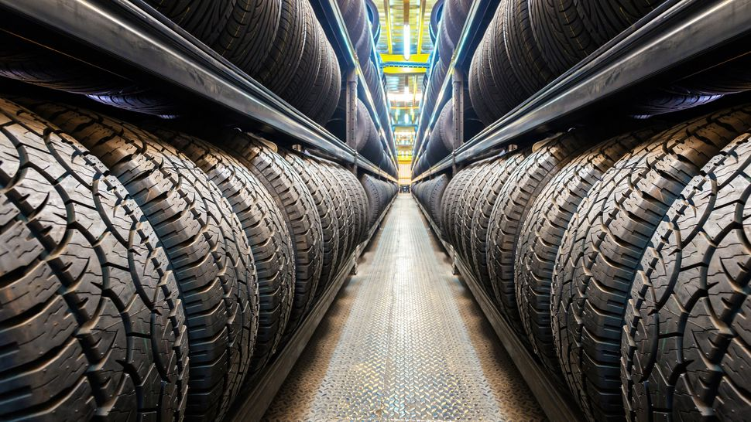
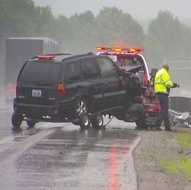
Engineering Tire Performance and Wear
Optimizing friction of tires on different surfaces
is a major engineering effort.
The global market for tires to reach $319B by 2022
Notes:
R&D for manufacturing tires for many applications is a big business. Scientists and engineers continue to advance the technology to assure optimized friction, wear and “feel.” There are many different surfaces and road conditions to consider.

Slide 11
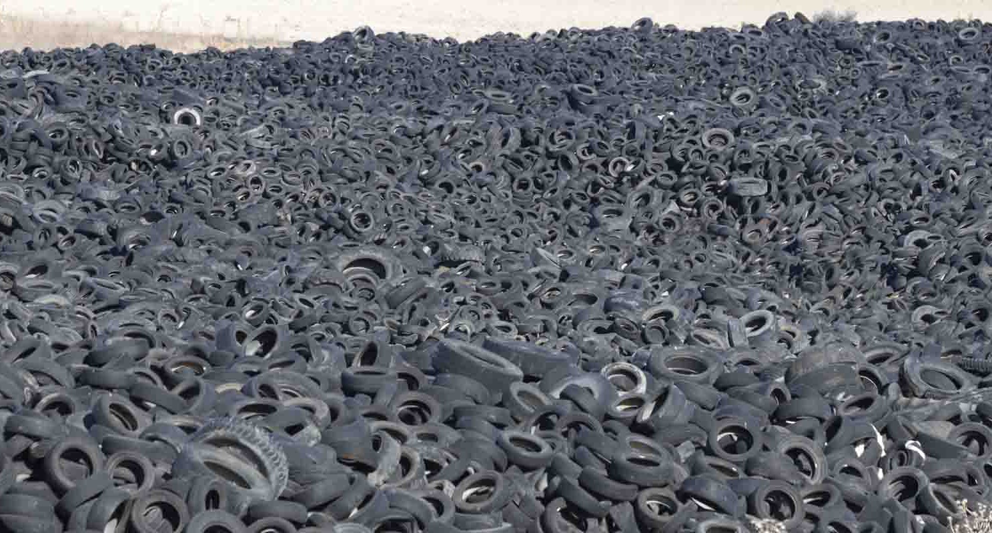
Where do 3 billion “worn out” tires go each year?
Design and manufacturing of tires must also include optimizing
their properties to enable effective recycling or reuse.
Notes:
Over the years, it has become clear that scientists and engineers must also find ways to assure that the tires can be effectively recycled following their useful lifetime. Scientists and engineers need to find solutions that provide the performance that people expect while enabling recycling. Many of the chemicals that are used in tire production over the years have changed to comply with stricter environmental regulations and reduce environmental impacts (e.g., through recycling).
In 2017 in the U.S.:
43% of used tires were burnt as tire-derived fuel (with cement manufacturing the largest user)
25% were used to make ground rubber (used in asphalt pavement and cement)
8% were used to make ground rubber
17% were disposed in landfills
8% other uses
It is currently not practical to use more than 5% recycled rubber in new tires.

Slide 12
Friction: Both Good or Bad
Where is it important to minimize friction?
Notes:
Allow students to share their experiences where is desirable to make frictional forces as low as possible.

Slide 13
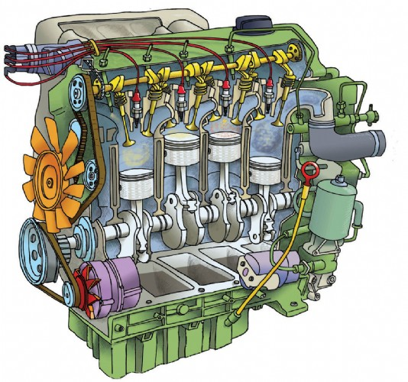
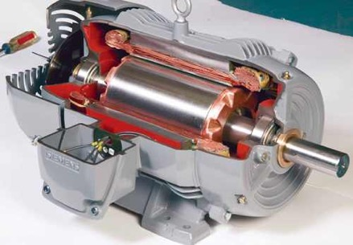
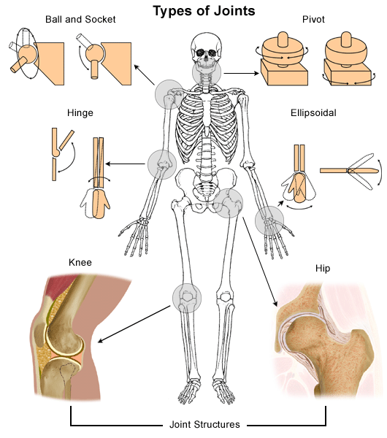
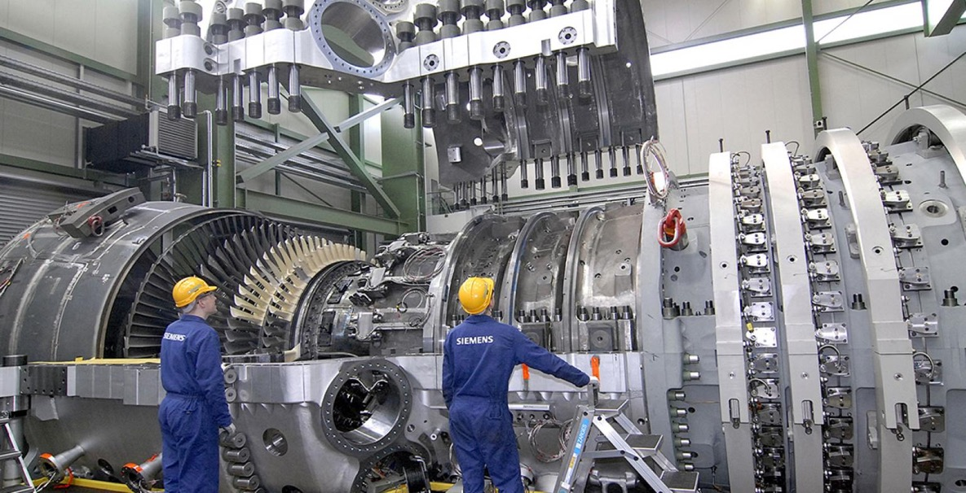
Friction BAD !
Notes:
Reduction of friction in many mechanical systems with repetitive motion is desirable. This is true in combustion engines, electric motors and large turbines used for power generation.
Reduction of friction in joints is something that evolutionary biology has done very well. When joints in the body fail, new replacement joints must be engineered to have minimal friction so that they do not to wear out in the patient's lifetime.

Slide 14
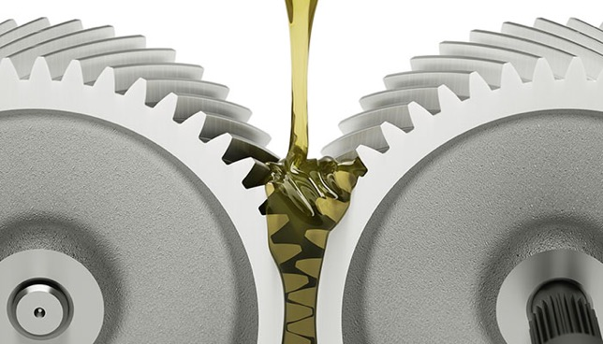


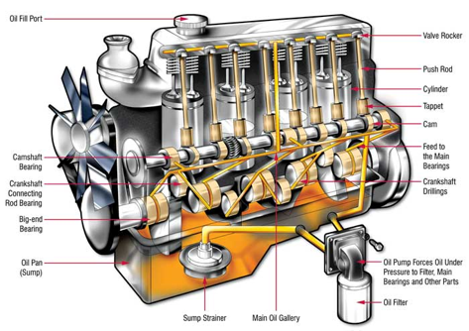
Reducing Friction is Big Business
The global market for lubricants expected to reach $166 B by 2021
Notes:
Lubrication of surfaces to reduce friction has become a big business. Most drivers understand the importance of keeping oil level maintained in their cars and the need to change the oil at regular intervals. New synthetic oils have made a big difference in reducing engine wear and extending oil lifetime. The disposal of used oil is also an important environmental concern and recycling must be incorporated into the design of lubricants from the start.

Slide 15
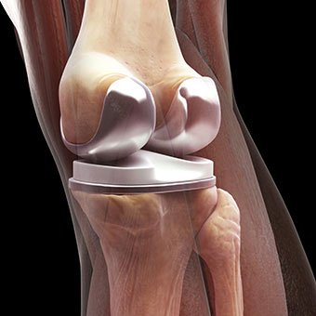
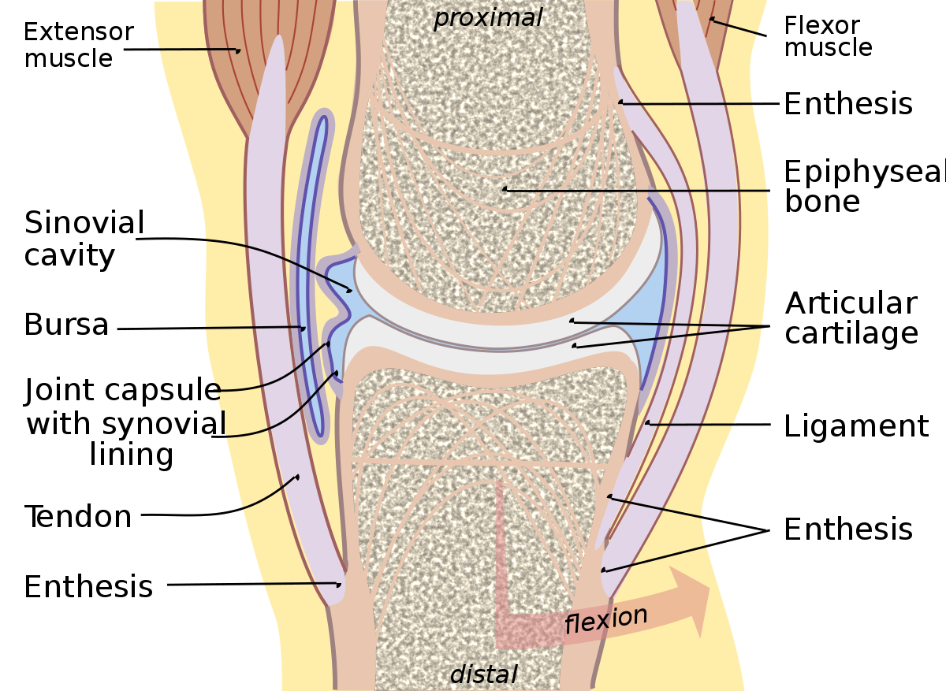
Friction in Human Joints
In 2017, there were ~400,000 hip and ~700,000 knee replacements in the United States.
Understanding friction and long-term wear is critical to extending the lifetime of the artificial joint and maintain comfort.
Notes:
Advances in medicine and the design of artificial joints have made the surgical process for replacing joints possible. Assuring that artificial joints are biologically compatible and maintain their properties over the lifetime of the patient is a continuing R&D challenge.

Slide 16

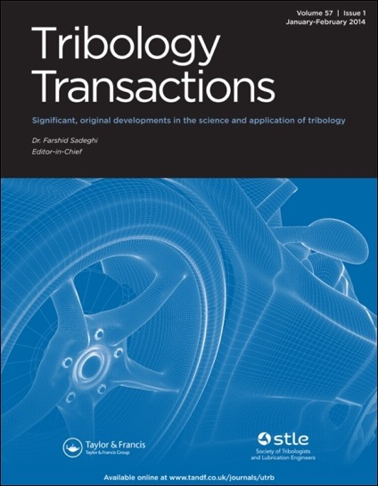


Tribology is the study of the interaction of sliding surfaces. It includes three subjects: friction, wear, and lubrication. Friction is often characterized as a branch of physics; wear is part of material science; and lubrication is a branch of chemistry. Tribology is a complex interdisciplinary science that is the subject of intense research due to its great importance to our daily lives.
Many journals are dedicated to research on tribology
Notes:
Introduce the term “tribology.”
The economic importance of tribology drives a large research and development effort. A number of journals that are dedicated to tribology are shown. Tribology research is also published in many other journals.
This is a great example of “cross-cutting” science and technology. As stated above, friction is traditionally a branch of physics, wear is a part of material science and lubrication is a branch of chemistry. The previous discussion of joints shows the intersection with medicine. This is a great moment to help students understand that various scientific and engineering disciplines must be combined to solve most big challenges.

Slide 17
Environmental Impact
23% of the world’s energy consumption originates from tribological contact (i.e., energy that does not do useful work)
  20% used to overcome friction
  3% to replace worn parts
It is estimated that energy losses due to friction and wear could be reduced by 40% in the next 15 years, resulting in:
  Reduction of energy use by 8.7%
  Annual reduction of CO₂ emission by 3,140 million metric tons
Notes:
This data came from an article “Influence of tribology on global energy consumption, costs and emissions”, Friction 5(3): 263–284 (2017).

Slide 18
A first step in understanding and controlling friction is to be able to measure it.
If we can accurately measure friction, we can then test methods for changing friction.
Kinetic friction is friction acting on an object when the object is in motion
Let’s measure kinetic friction
Notes:
Our first experiment will concentrate on kinetic friction. We will measure static friction later.

Slide 19
Experiment 1A

Slide 20
Experiment 1A
Measure the coefficient of kinetic friction
  Using the experimental design described on the next few pages, measure the acceleration of your phone as well as the displacement.
    On a diagram of acceleration vs time, explain what is happening where you observe abrupt changes in the acceleration.
    Sketch a graph of your data and then draw a free body diagram for:
      The time of maximum acceleration (moment right after the phone is released)
      The time where the acceleration is zero while the phone is still moving
      The time of constant negative acceleration when only friction is acting on the moving object
  Using your measured value of the acceleration due to friction, calculate the coefficient of kinetic friction, μ_{k}.
Notes:
Students will learn quickly how to optimize the experiment. Different groups will identify different important factors in optimizing the experiment. One strategy is to allow students to work through experimental designs on their own for 5-10 minutes. After initial trials, stop and discuss what might constitute a “good” graph of acceleration vs time. Let students share what they observed and discuss how they might improve their experimental design and any useful features of the application that they discovered. Teachers can decide how many of the tips below they want to share with students prior to starting the experiment. If there are some high-quality data from one of the groups, show students that example. Teachers could also show example data from the following package.
Set-up of the Experiment for Optimum Data:
Connect elastomer symmetrically to the phone to minimize rotation. Rotation will manifest itself as slopes in the acceleration (rather than a constant value), varying as the frictional force acts on the phone in the x or y plane. When there is limited rotation, the acceleration will be on either the x or y axis, depending on the orientation of the phone. Students can explore if there is an optimum axis. Pulling along the y-axis (narrow axis) generally provides less rotation. Also the sign of the data will depend on the orientation. Pulling along the positive axis makes it a little easier to associated the initial acceleration by the elastomer as positive and the frictional force producing a negative acceleration.
The elastomer can be attached to most cases by inserting a small part into the edge. If the rubber band is placed between the phone and the back of the case, it can result in a bulge that can impact the measurement (a little). Sliding on a flat surface will yield the best data. Wrapping the rubber band around the phone so that it is sliding on the rubber band does not work well.
The elastomer is angled up so that it will not be in the path of the sliding phone. Be sure that the rubber band done not interfere with the sliding phone movement. Applying the elastic force at an angle does result in a component of the elastic force along the z-axis. This will not impact the key region of the graph where only friction is acting on the phone in the x-y plane but it does have a small impact on the detailed curvature of the acceleration when the elastic force is acting on the phone. Students could investigate this if they desired.
Use an elastomer that is long enough to sufficiently accelerate the phone without hitting the object holding the other end of the rubber band. This can be accomplished by creating a small chain of rubber bands (shown in later slide).
Keep the sliding surface clean and uniform. Clean the surfaces before doing the experiment and check for any nonuniform spots on the phone case or surface. (e.g., Residual from erasing left on a surface can effectively alter the uniform frictional force.)

Slide 21
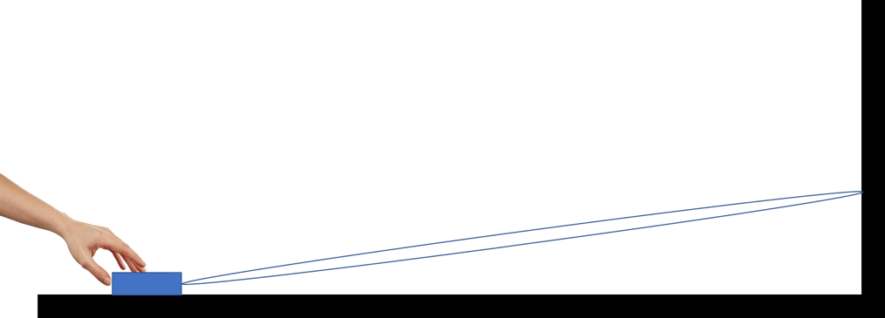
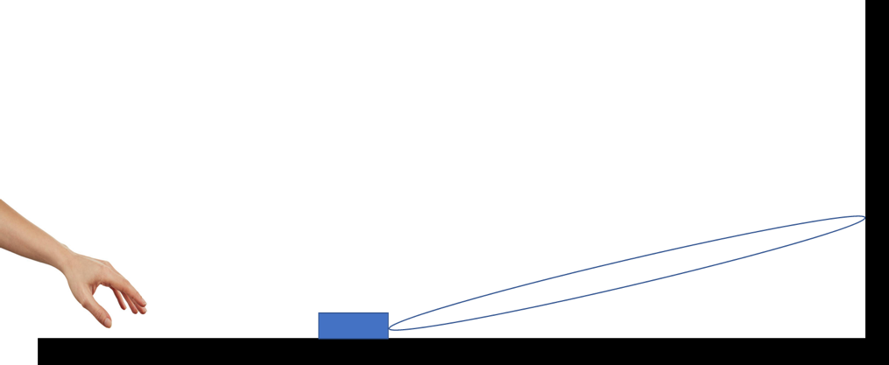
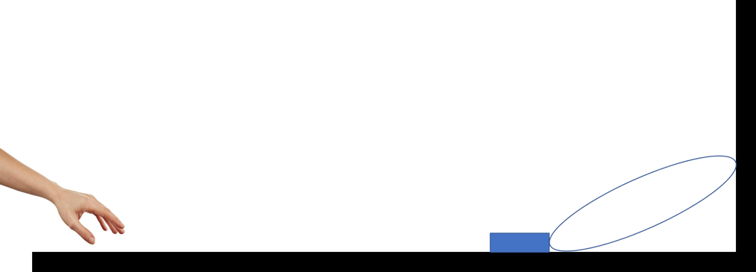
1
2
3
Notes:
Quick visual that helps explain the simple but eloquent experiment.

Slide 22
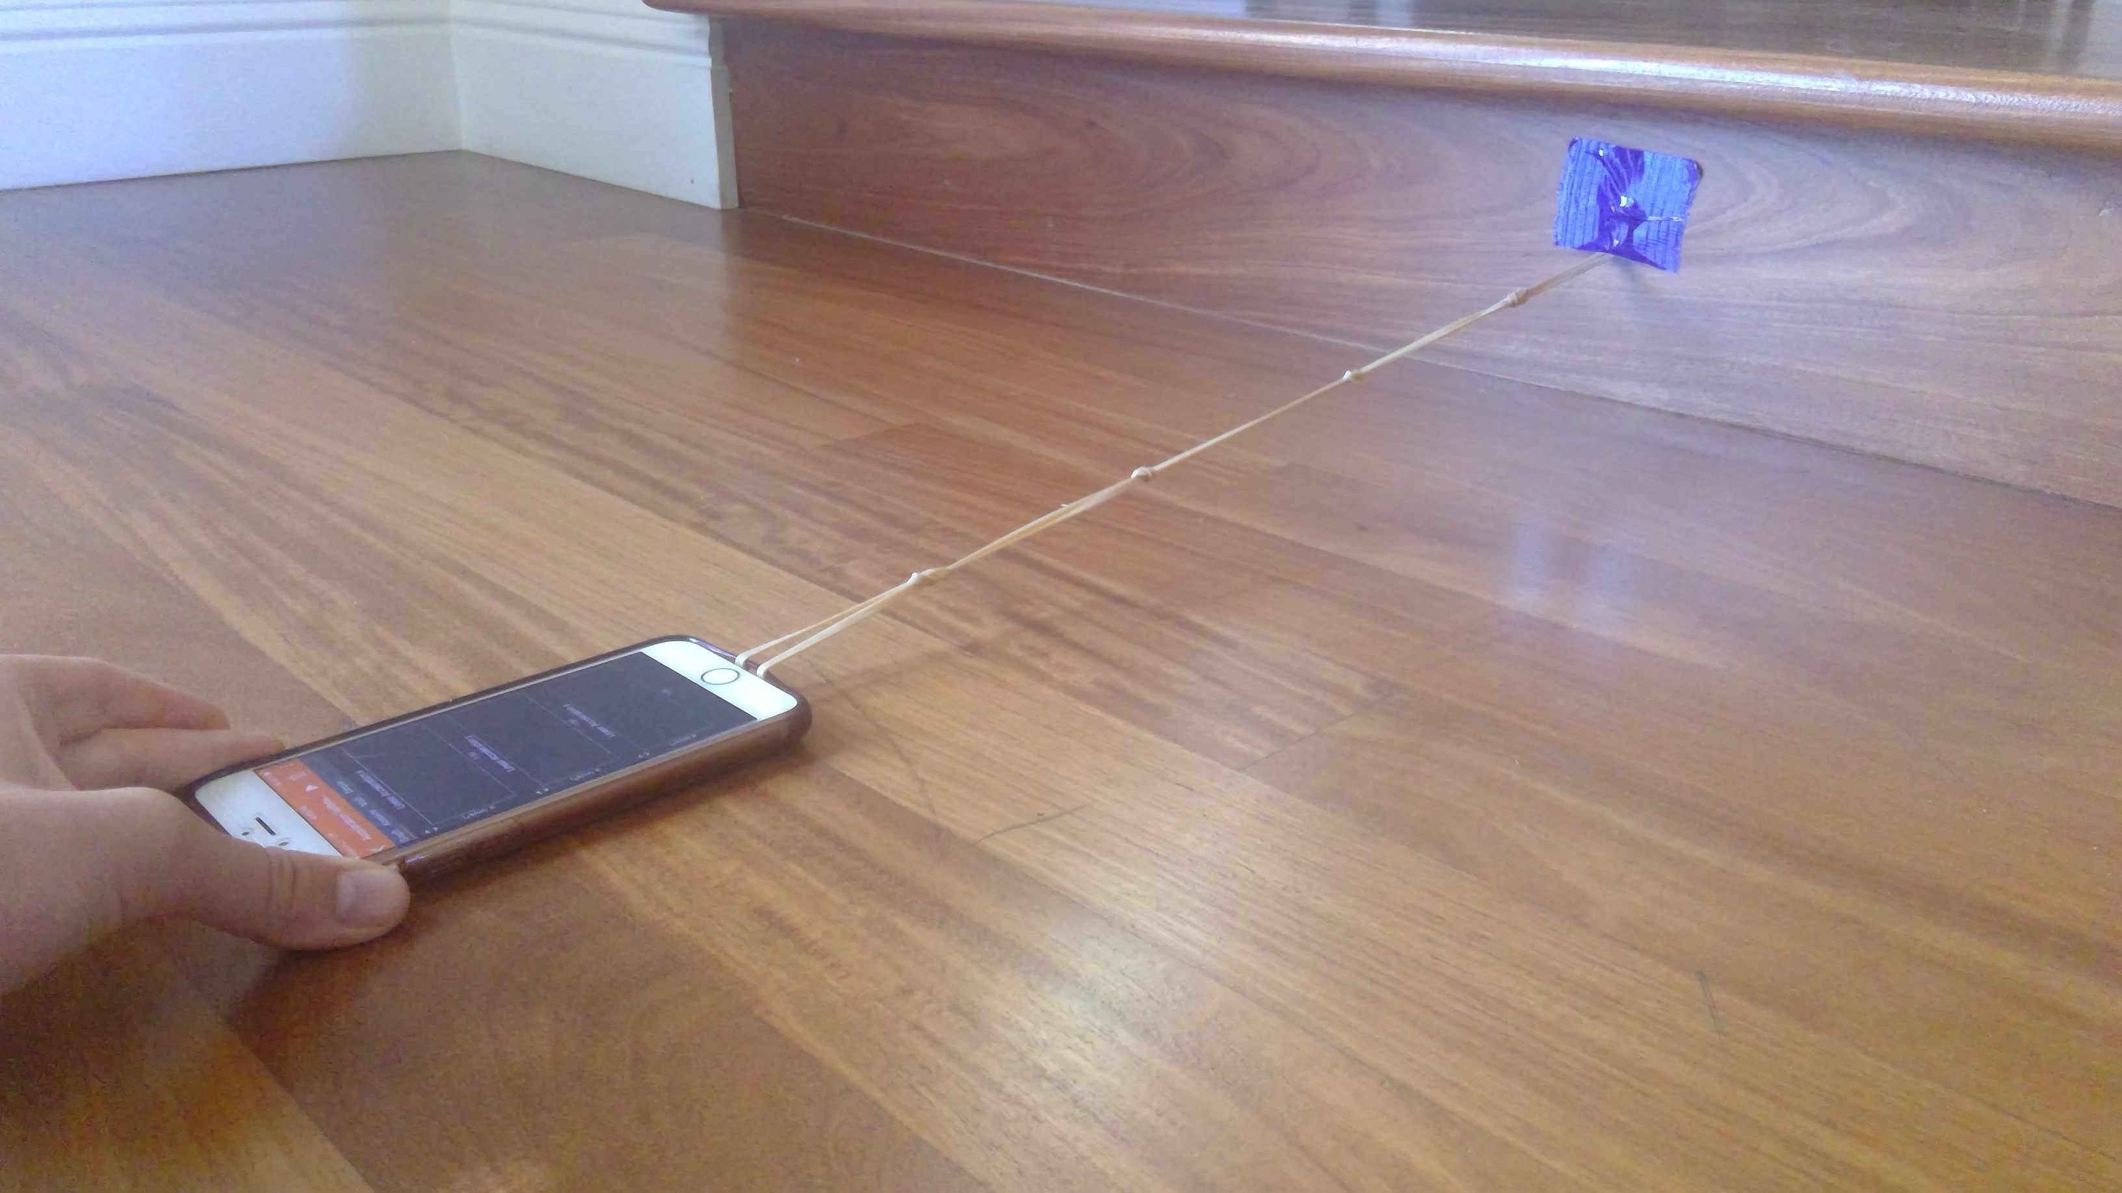


Slide 23
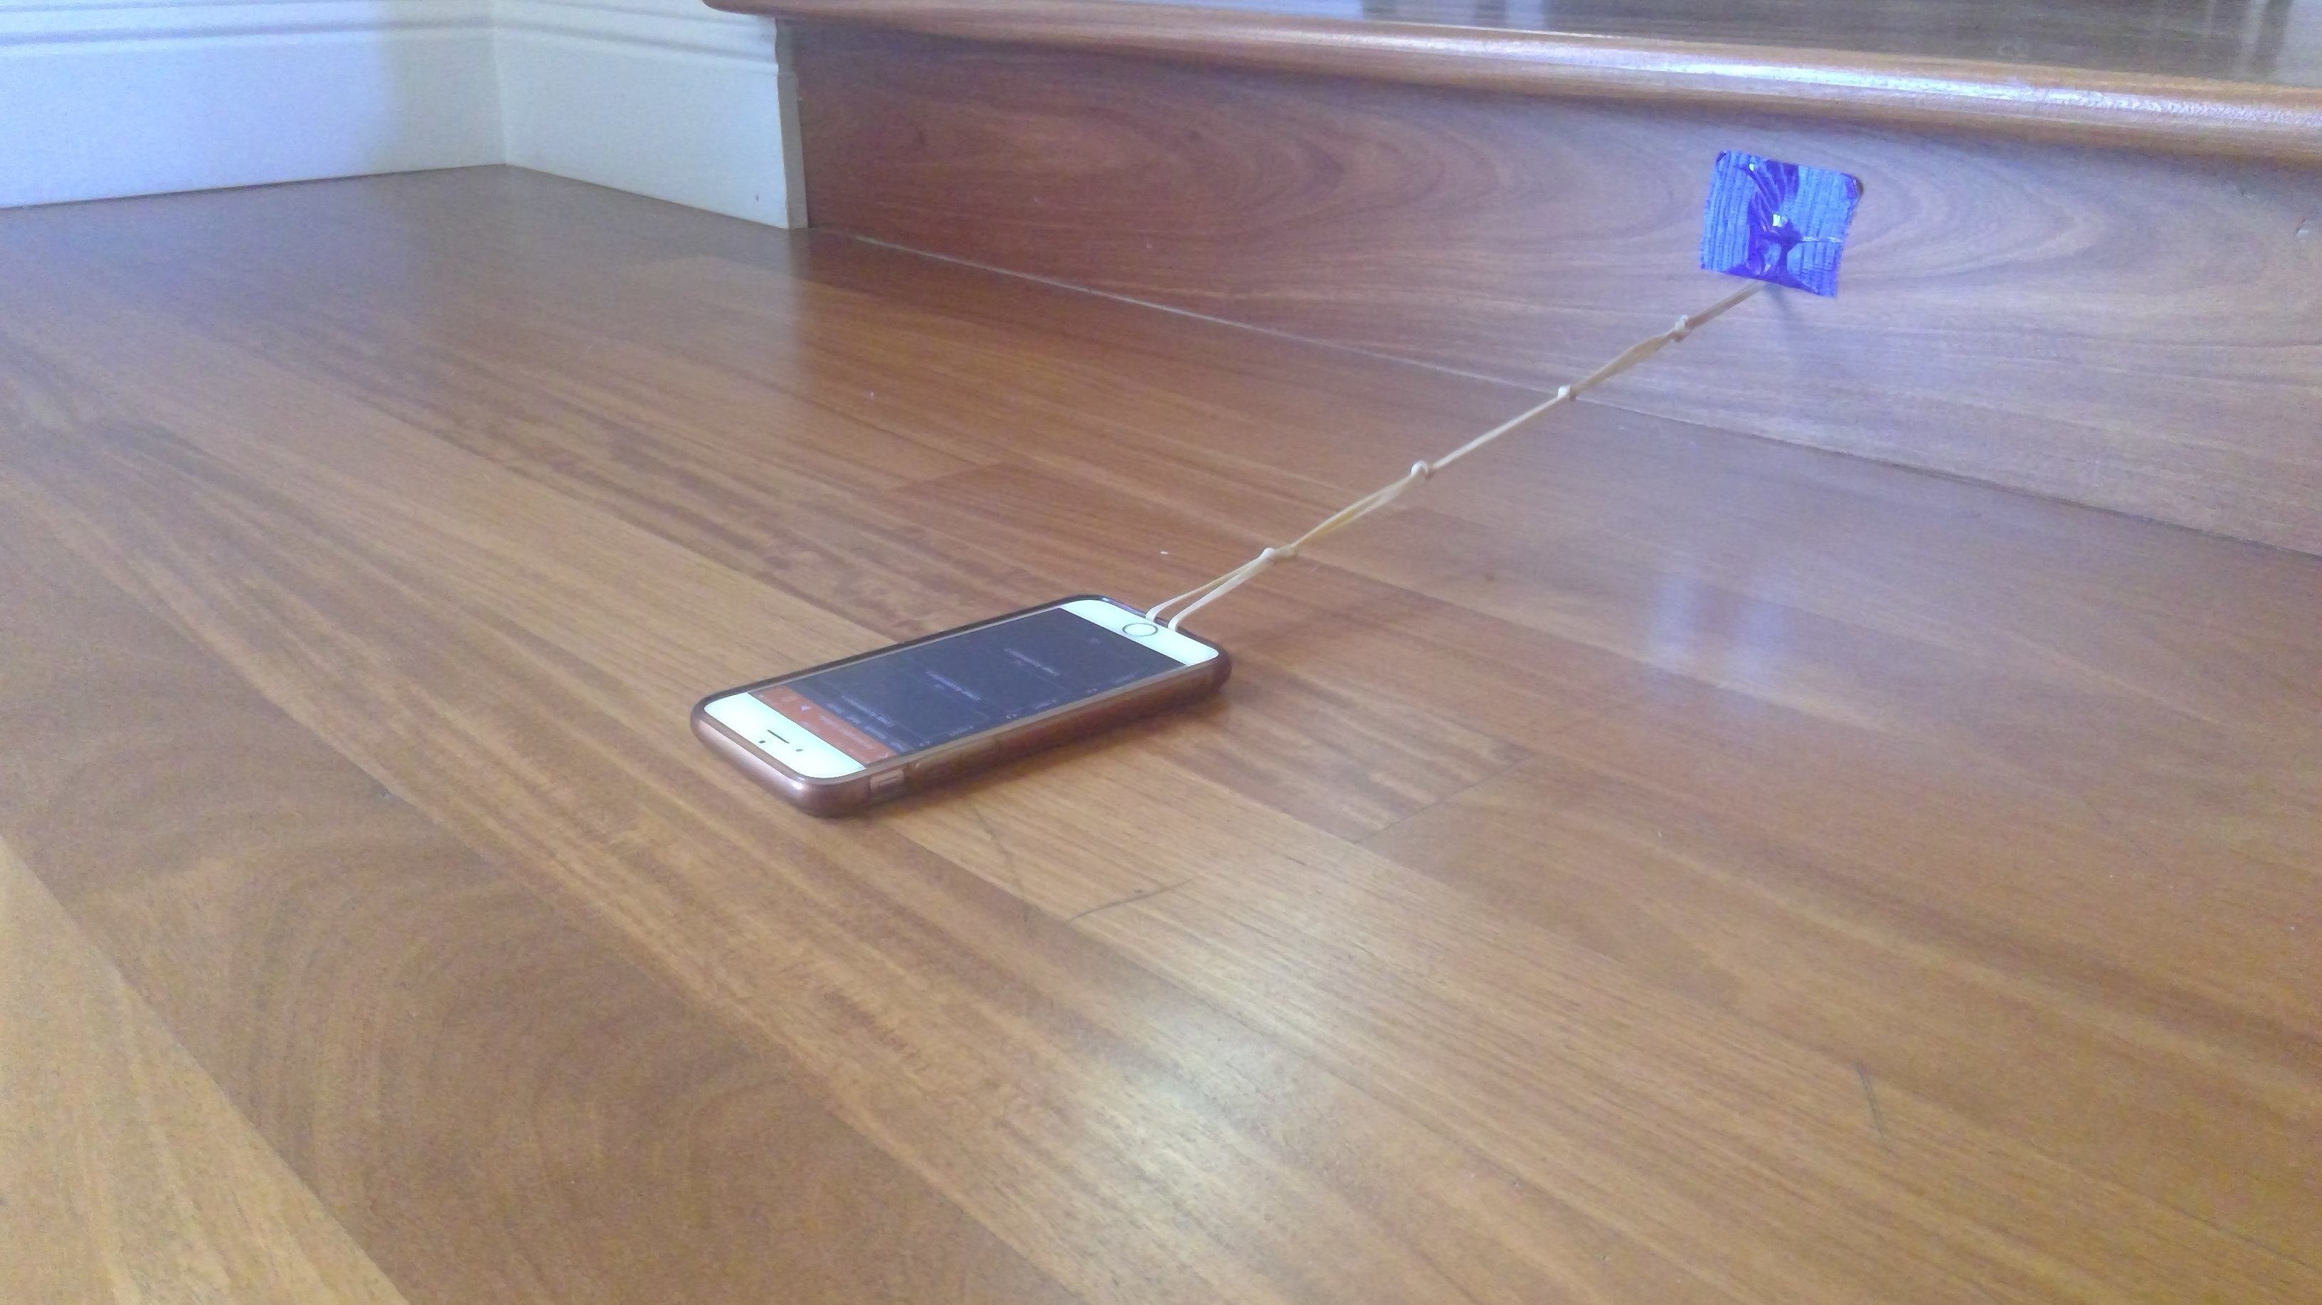
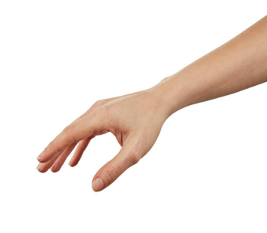

Slide 24
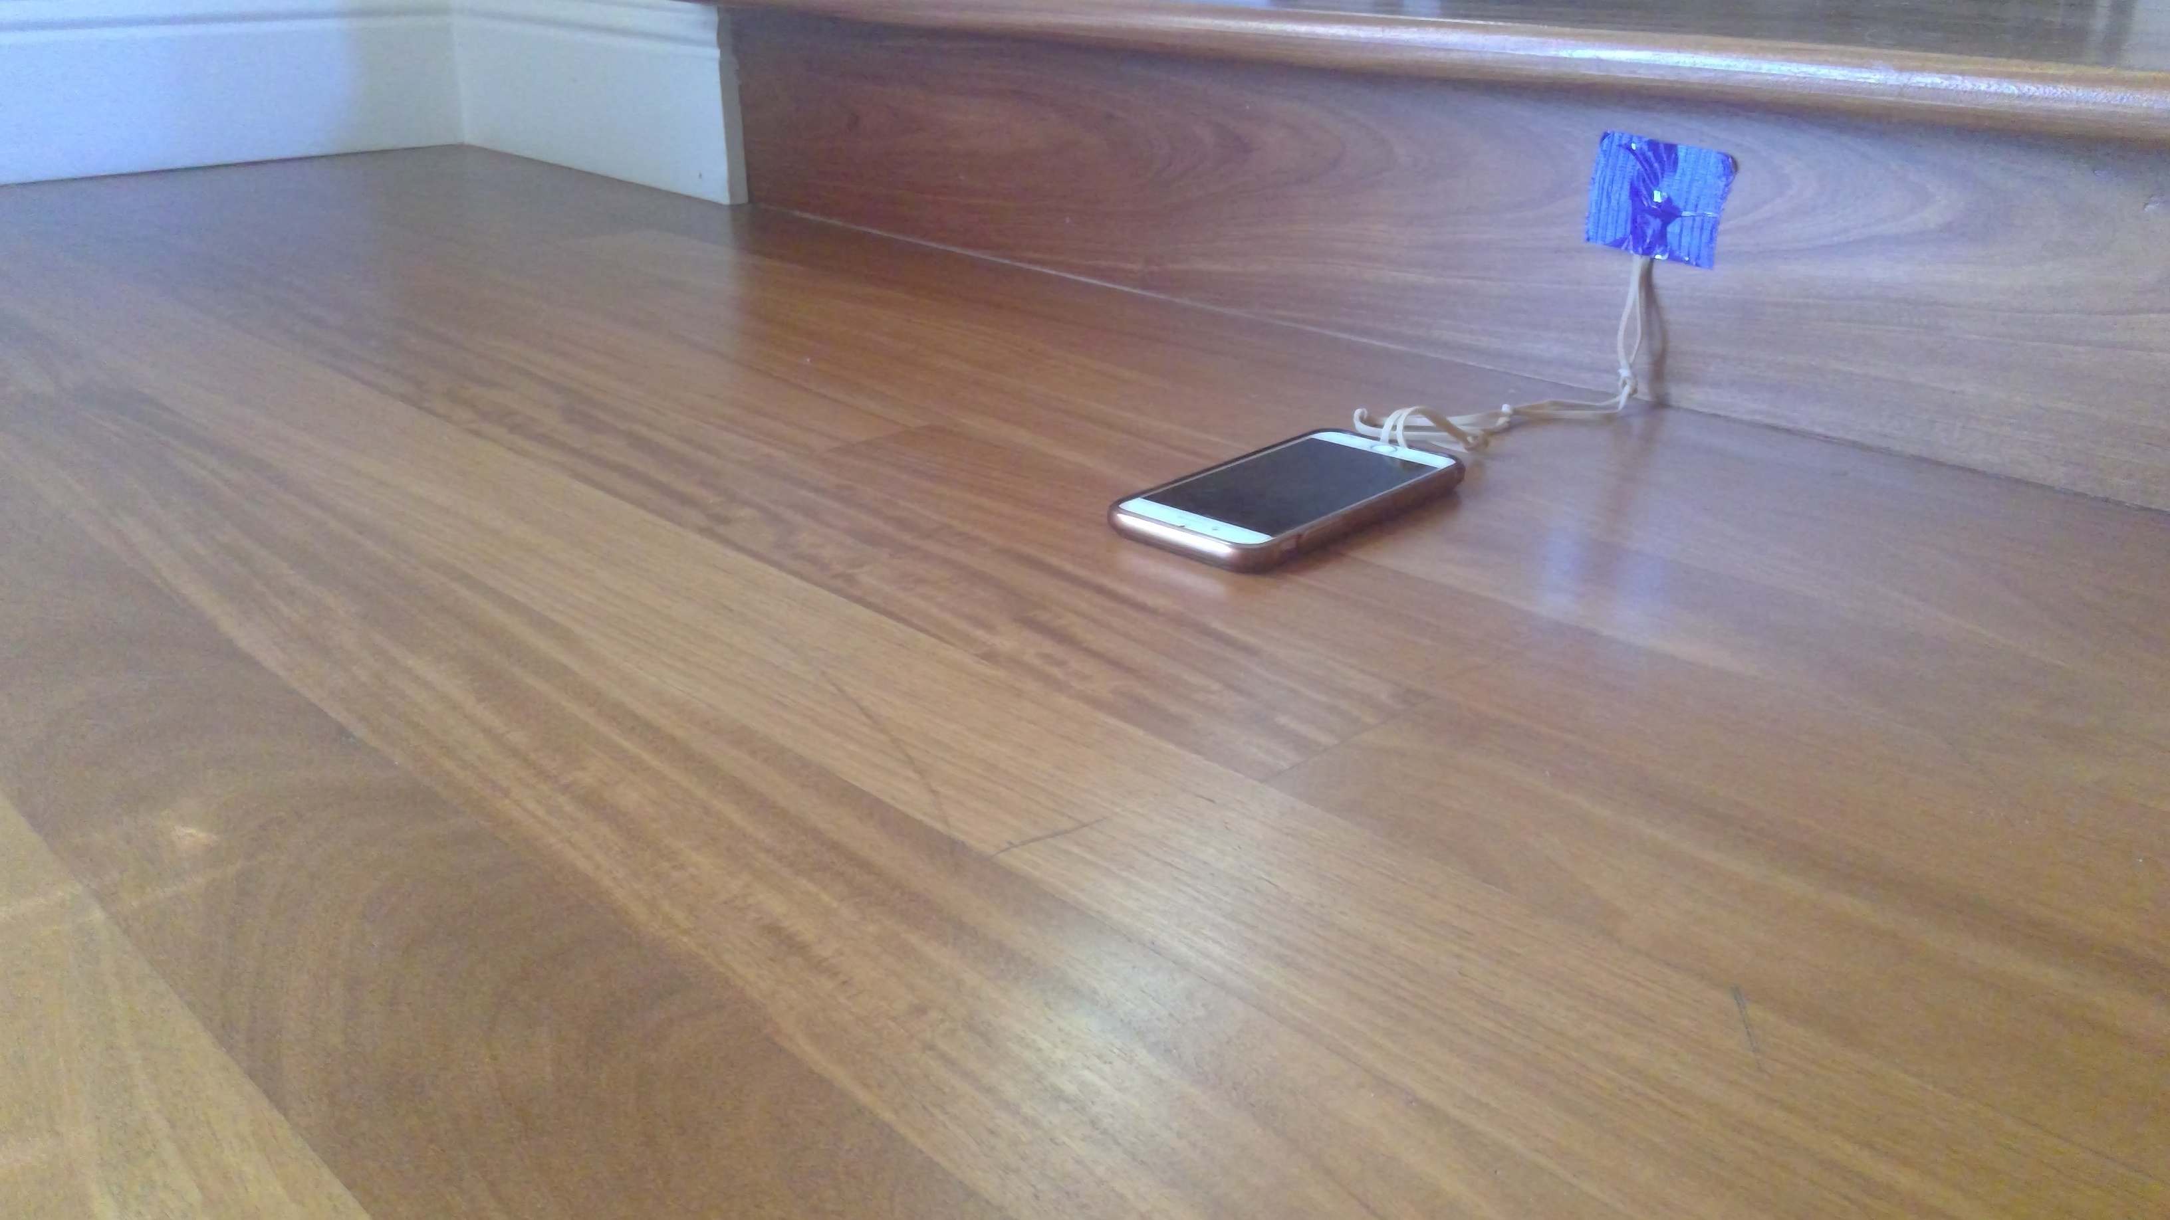

Slide 25
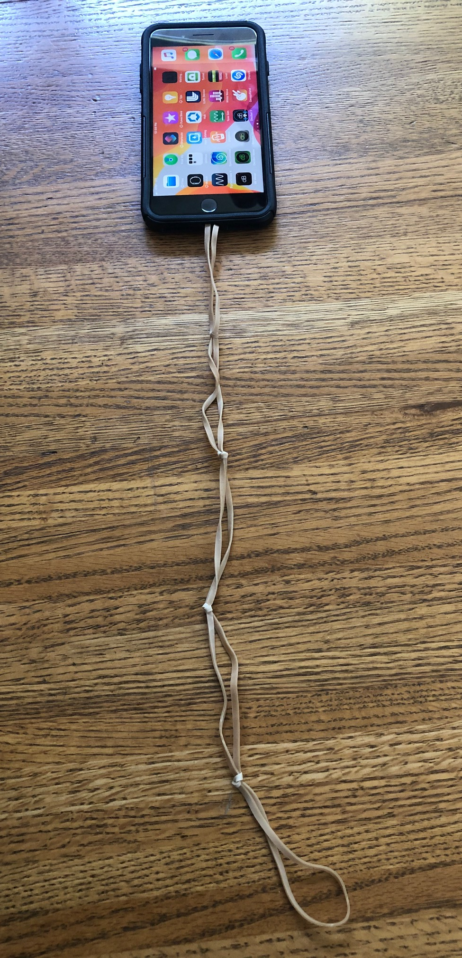
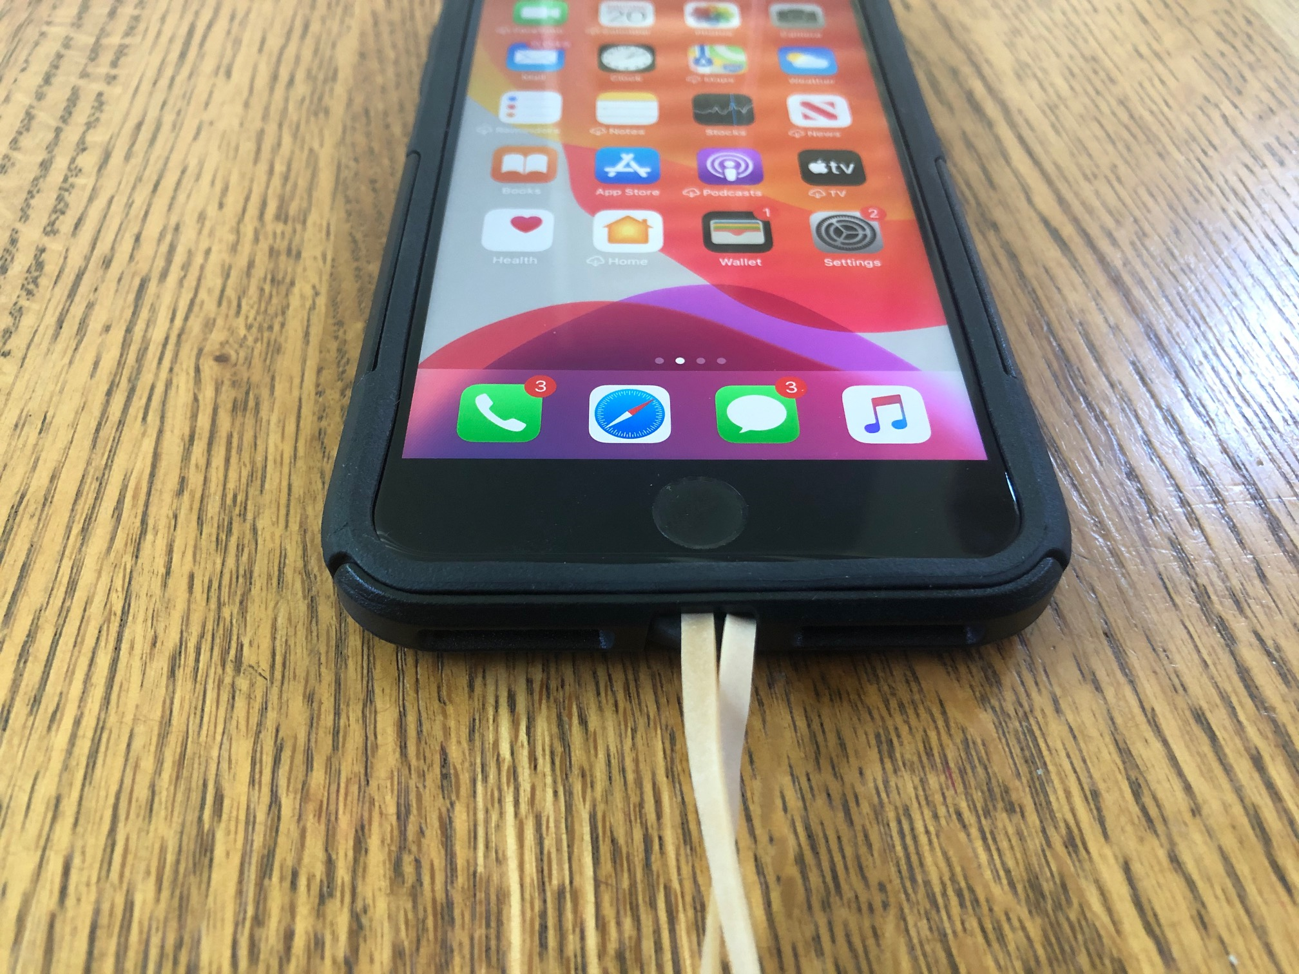
Example Method to Connect Rubber Band Chain to Phone
Multiple rubber bands are daisy chained to create a “chain”.
The rubber band is tucked inside the lip of the case.

Slide 26
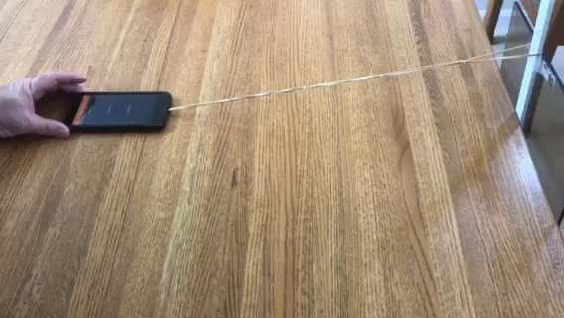

Slide 27
Example Data, Analysis, and Calculations

Slide 28
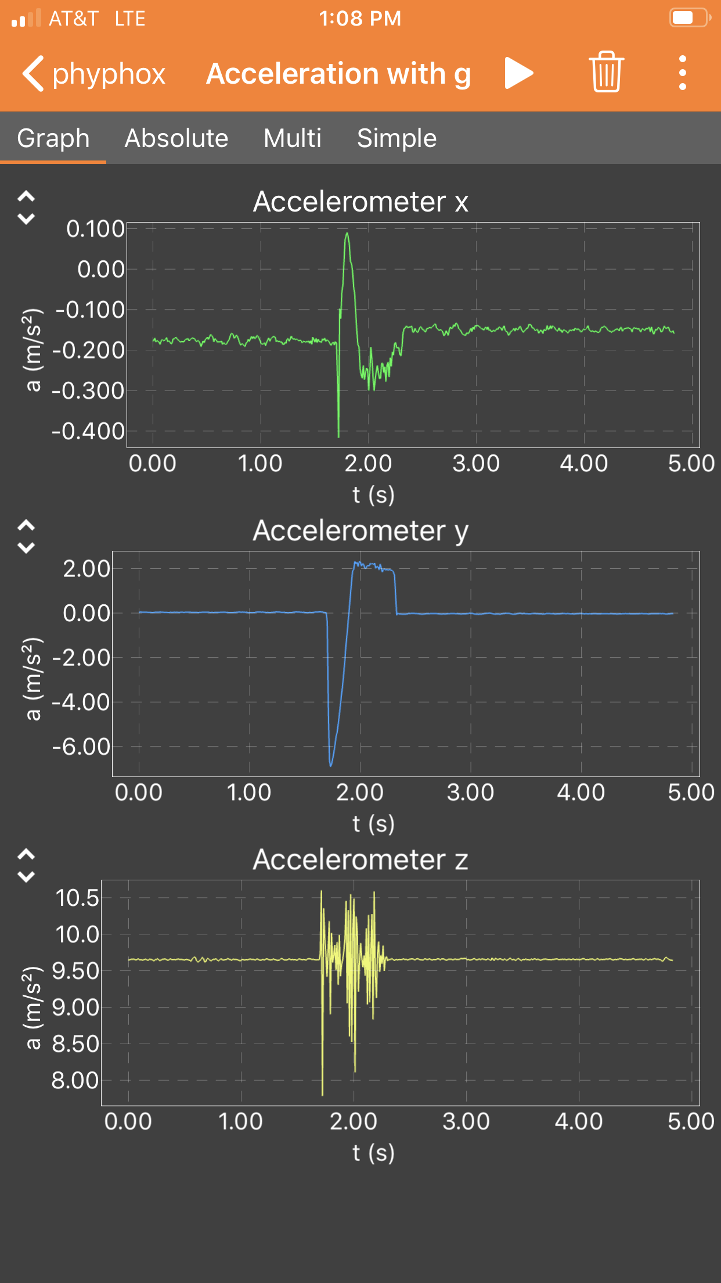
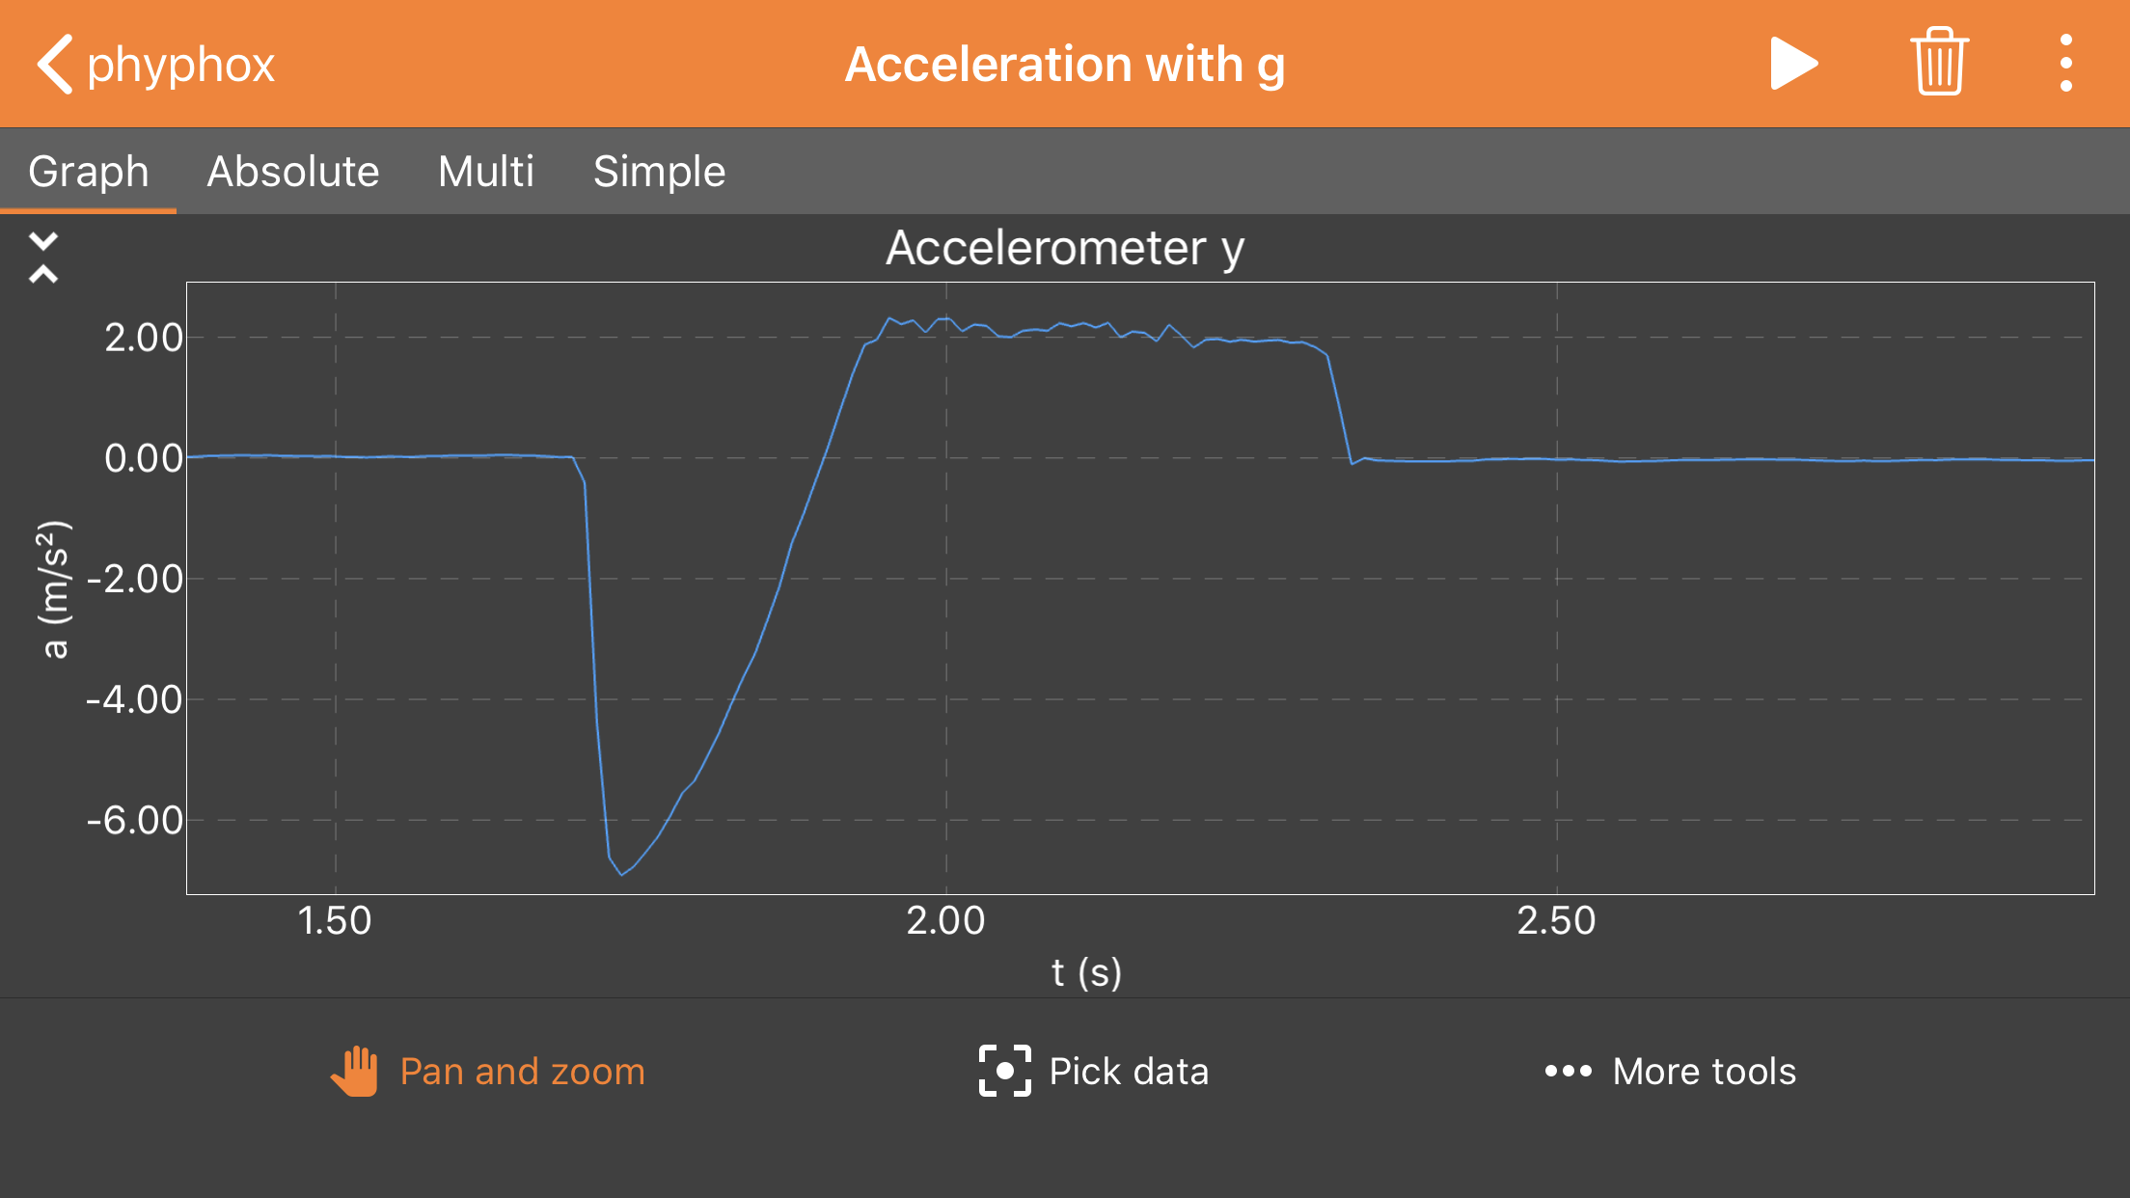
Example Experimental Data
Observed using Phyphox
Notes:
This is an example of the raw data collected using phyphox. In this case the phone was accelerated along the negative y axis.

Slide 29
Rubber band extended
Maximum elastic potential energy
Phone being held
Notes:
This series of slides steps through a description that connects the observed data with the experiment as a function of time. The initial period of zero acceleration occurs while phone is being held.
Depending on the phone orientation, students could get a mirror image of this data across the x axis.

Slide 30
Phone released
Static friction insufficient to hold phone in place
The large net force due to the elastic force results in acceleration
Notes:
As soon as the phone is released, the elastic force much larger than the static friction so the phone begins to move. The elastic force is also much larger than the force from kinetic friction, so the phone accelerates according to Newton’s second law.

Slide 31
Notes:
Maximum acceleration occurs almost immediately after release of the phone when the rubber band is at its maximum elongation and produces the maximum elastic force. The sensor has some response time and there is some variation in the release time. Slow release by the fingers of the experimenter can be observed as there can be some frictional force from the experimenter's fingers as the phone begins to move. Some potential energy is used to overcome static friction – this is not observable from this data. The exact shape of the maximum acceleration does vary some and might be an interesting topic for further discussion.
The force from kinetic friction is a constant for the entire time the phone is moving. (To first order. Depending on the angle of the rubber band, there is a component of the elastic force along the z-axis that will reduce overall normal force and therefore the frictional force. This might be identified by the observant student. It does not impact the measurement of the coefficient of friction which is derived from the acceleration when only the frictional forces is acting on the phone.)

Slide 32
Notes:
The green lines indicate the time when the elastic restoring force is acting on the phone. This is a complicated function where the elastic force is changing with time. The details of the shape are left for discussion by the interested student.

Slide 33
Maximum Velocity
Notes:
The maximum velocity will occur just before the force from friction becomes larger than the elastic restoring force (acceleration ≥ 0.0 m/s²). The velocity of the phone begins to decrease when net negative acceleration is begins. (See graphs later in presentation.)

Slide 34
F_{elastic} = 0
F_{friction} = constant
Constant Acceleration
Notes:
The bracket indicates the time when the phone is “sliding” on the table after the elastic restoring force goes to zero. During this time, only the friction force is acting on the phone in the x-y plane. This results in constant negative acceleration.
When collecting data, it is important to choose an experimental condition where this “constant” acceleration is easily observable. If the phone does not slide for very long after the restoring force goes to zero, the acceleration vs time plot will look more like a negative hump and the key idea of constant negative acceleration does not become as clear to the student. If the constant acceleration time is too short, increase the initial elastic force (increase the stretching of the rubber band).

Slide 35
Velocity = 0
Notes:
Eventually the phone comes to a stop and the acceleration abruptly goes to zero. This transition is limited by the sensor response time but is very fast (<0.02 seconds).

Slide 36
SUMMARY
Phone released
Static friction insufficient to hold phone in place
Maximum Velocity
Velocity = 0
Rubber band extended
Maximum elastic energy
Phone being held
F_{elastic} = 0
F_{friction} = Constant
Notes:
This graph provides a summary of all the explanations.

Slide 37
Free-Body Diagrams
F_{normal}
F_{friction}
F_{elastic}
F_{friction}
F_{elastic}
F_{gravity}
F_{friction}
F_{elastic}
F_{friction}
Notes:
Free-body diagrams for 3 key times during the experiment. The normal force and the force of gravity are shown in the box. The other free-body diagram only show the forces that are impacting the change in the x- or y- axis acceleration during the experiment.
Students may recognize that there is also a component of the elastic force along the axis of the normal force because the experimental design has the rubber band at a small angle. This force will only be present while the rubber band is extended beyond its equilibrium position. It does not impact the measurement during the time when the coefficient of friction will be measured.

Slide 38
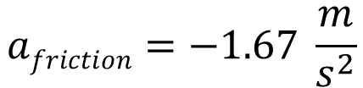
F_{friction}
F_{elastic}
F_{friction}
F_{elastic}
F_{friction}
Notes:
The acceleration due to friction can be estimated from the graph. This is easily done from the graphical interface on the phone and does not require exporting and plotting.

Slide 39
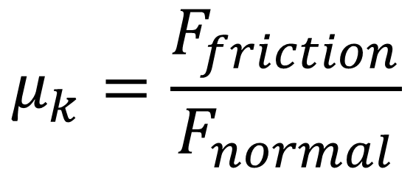
Coefficient of Kinetic Friction (μ_{k})
$$μ_{k}=\frac{F_{friction}}{F_{normal}}$$
The coefficient of kinetic friction is the ratio of the force of friction and the normal force acting on the object when the object is moving.
The Coefficient of Friction
Unitless
Only depends on the
properties of the two surfaces
Notes:
Introducing the coefficient of kinetic friction which is used for quantifying the friction between surfaces. The coefficient of friction has no dimensions and depends only on the properties of the two surfaces.

Slide 40


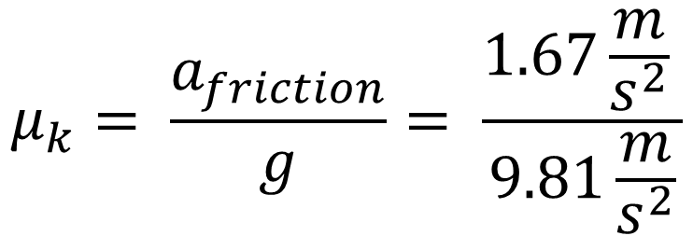

Calculation of Coefficient of Kinetic Friction (μ_{k})
1)
2)
Notes:
Calculation of the coefficient of kinetic friction. Students may think they need to know the mass of the phone to do this calculation. They will find that mass drops out and that they do not need it to calculate the coefficient of friction from the acceleration data.

Slide 41
Test your Knowledge

Slide 42
If the initial elastic force in doubled, which of the following would you expect? (select all that are true)
Larger initial acceleration
Larger maximum velocity
Larger total displacement
Larger force from friction
Larger value for the coefficient of friction
No change in the value for the coefficient of friction

Slide 43


If the initial elastic force in doubled, which of the following would you expect? (check all that are true)
Larger initial acceleration
Larger maximum velocity
Larger total displacement
Larger force from friction
Larger value for the coefficient of friction
No change in the value for the coefficient of friction
Notes:
The frictional force and the coefficient of friction is independent of the velocity so they will not be changed by the doubling of the elastic force.

Slide 44
If the rubber band remains partially elongated when the phone stops, what would you expect? (select all that apply)
No worries, it is still possible to determine the coefficient of friction from the data even though both the elastic and frictional forces were acting on the phone during the entire time it was moving.
There will not be a time of constant acceleration due to friction, so it will not be possible to determine the coefficient of friction from the data.

Slide 45
If the rubber band remains partially elongated when the phone stops, what would you expect? (check all that are true)
No worries, it is still possible to determine the coefficient of friction from the data even though both the elastic and frictional forces were acting on the phone during the entire time it was moving.
There will not be a time of constant acceleration due to friction so it will not be possible to determine the coefficient of friction from the data.

Slide 46
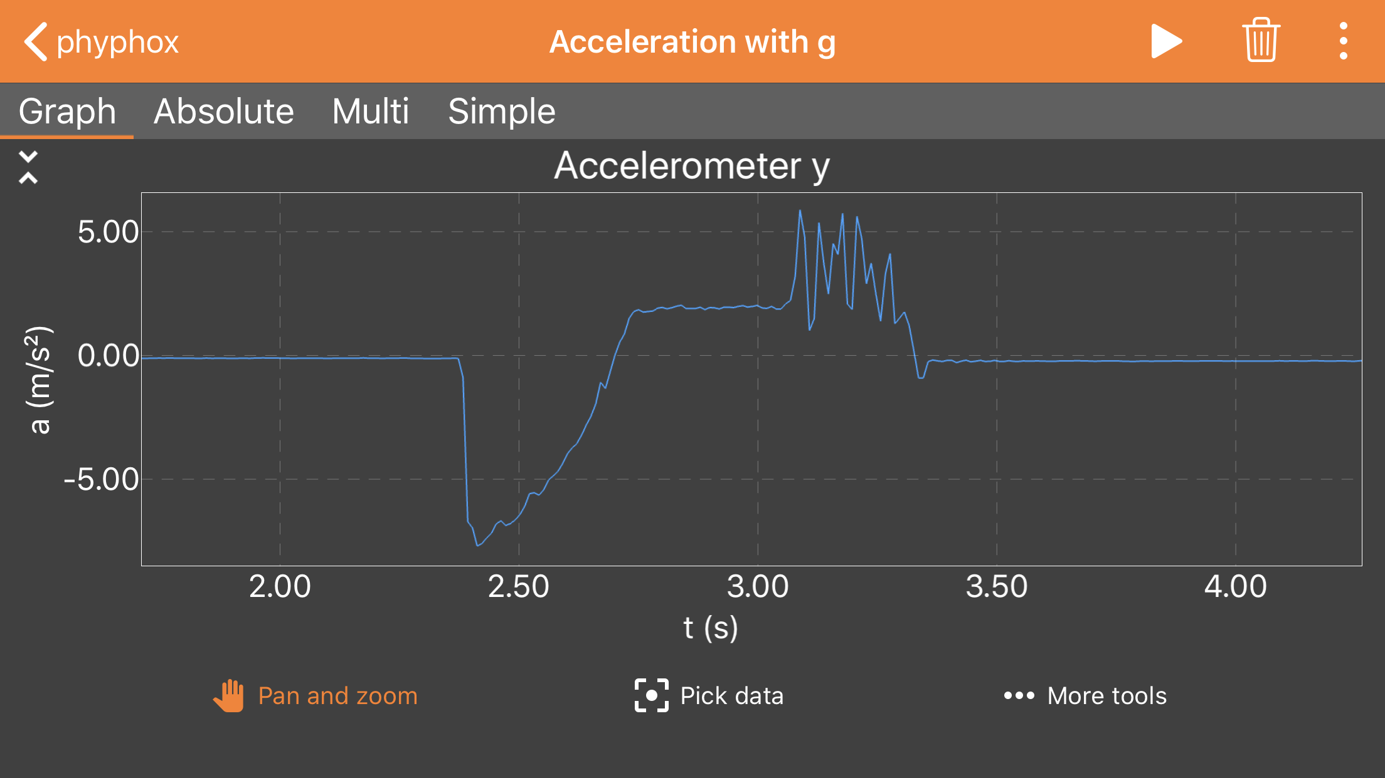
Darn, my phone hit the rubber band at the end of my experiment. I will not be able to calculate the coefficient of friction so I will need to do another experiment.
Is this the correct conclusion?
Yes
No
Notes:
This is a common event during this experiment. Sometimes the phone will also be stopped by other collisions.

Slide 47
Darn, my phone hit the rubber band at the end of my experiment. I will not be able to calculate the coefficient of friction so I will need to do another experiment.
Is this the correct conclusion?
Yes
No
Notes:
To calculate the coefficient of friction, one only needs to know the value of the acceleration due to friction for a short period after the elastic force is no longer being applied. This is easily determined from the data. The white square marks the region of constant acceleration due to friction.

Slide 48
Experiment 1B

Slide 49
Experiment 1B
Measure the coefficient of kinetic friction
  Graph acceleration vs time using a spreadsheet.
    Calculate the maximum velocity using a rectangular integration method to estimate the area under the acceleration vs time curve.
    Using your spreadsheet, calculate the velocity of the phone at each point using the relationship between acceleration, velocity and time.
    Using your spreadsheet, calculate the displacement of the phone at each point using the relationship between velocity, displacement and time. Compare the calculated displacement to the displacement you measured in your experiment.
Spreadsheet analysis of acceleration, velocity and displacement
Notes:
This activity assumes that students can graph the data using a spreadsheet. Students can be provided a graph to do part 3a if they do not have the ability to do graphing and calculations on a spreadsheet.
This activity is a good introduction to the idea of integration and the power of calculus which student that continue in physics will eventually learn.

Slide 50
Example Data, Analysis, and Calculations

Slide 51
Estimating Change in Velocity During Positive Acceleration
The area under this curve is the maximum velocity.
The phone starts to experience negative acceleration and will begin to slow down.
Notes:
The velocity can be determined by integrating the acceleration as a function of time.

Slide 52
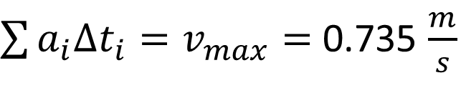
Estimate the Change in Velocity (Maximum Velocity)
Determine Area Under the Acceleration vs Time Curve
Notes:
Graphical integration

Slide 53
This area must be the same as the area during positive acceleration.
Notes:
The integral of the negative acceleration should be the same since the phone is returning to zero velocity.

Slide 54
Estimate the Change in Velocity
Notes:
Graphical integration

Slide 55
The integrated acceleration verse time should be zero since our phone was at same velocity at beginning and end of our experiment: v = 0.0 m/s
7.35 m/s
7.39 m/s
Agreement within error of integration estimate
Notes:
This is good agreement for this crude integration method. It is important for students to understand estimates and that these two numbers are in very good agreement despite the fact they are not identical to 3 significant figures.

Slide 56


Calculate the Velocity from the Acceleration vs Time Data
The velocity at each point can be calculated by adding the change in velocity for each time interval using the measured acceleration.
Notes:
This integration can be done more accurately using a spreadsheet.

Slide 57


Velocity Determined from Acceleration Data
Notes:
Each red data point was calculated using the formula on the graph for each blue data point. Note the secondary axis for velocity.
This allows the student to visually see how the velocity is changing and recognize key locations regions on the graph.
Near linear change in velocity with time when the elastic force is much larger than the frictional force.
The increase in velocity begins to slow as the elastic force and the frictional force become more equal.
The velocity is a maximum with the acceleration is zero and the sum of the elastic force and the frictional force is zero.
The velocity change is linear when the acceleration is due to a constant frictional force.
The velocity returns to zero. (This indicates that the data is very good because pointwise integration does not build up an error in calculating the final velocity.)

Slide 58
Velocity Determined from Acceleration Data
Maximum Velocity = 0.74 m/s
Notes:
The velocity is a maximum with the acceleration is zero and the elastic restoring force and frictional force are equal (but opposite in sign).

Slide 59

Instantaneous Velocity Determined from Acceleration Data
Notes:
The velocity change is linear when the negative acceleration is due to a constant frictional force.

Slide 60

Displacement Determined from Velocity
$$d_{i+1}=d_{i}+ v_{i}\left(t_{i+1}−t_{i}\right)$$
Δd = 0.31 m
Notes:
The displacement can be calculated in the spreadsheet from the velocity and time data. Students can verify that this calculated displacement matches the experimental displacement.
This analysis is very powerful in helping students connect position, velocity and acceleration (i.e., kinematics).

Slide 61
Test your Knowledge

Slide 62
How far does this phone slide before coming to a rest?
More information on the next page.
Notes:
Students can determine the time for which the phone is moving under the constant acceleration due to friction as well as the value for the average acceleration from this graph.
Δt = 1.026 s – 0.450 s) = 0.576 s
Average acceleration = -2.0 m/s²

Slide 63
Velocity and displacement calculated for the first 0.50 seconds
Notes:
Student can determine the velocity and displacement at the time the phone begins motion under the constant acceleration of friction.
v = 1.18 m/s
d = 0.29 m
The problem can be solved by calculating the distance the phone slides under constant acceleration and adding it to the distance that the phone moved prior to that time. The distance traveled while the phone is sliding under constant acceleration can be calculated several ways which are shown on the next few slides.

Slide 64

Approach #1
Solve for the distance during constant acceleration using:
$$∆d=v_{ave}∆t$$
Add this distance to the distance traveled when both the elastic and frictional forces were acting on the phone to get the total distance.

Slide 65


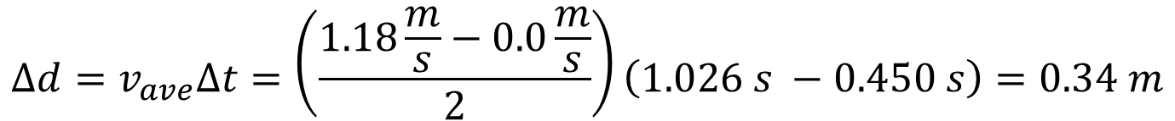

$$∆d=v_{ave}∆t=\left(\frac{1.18\frac{m}{s}−0.0\frac{m}{s}}{2}\right)\left(1.026 s −0.450 s\right)=0.34 m$$
$$∆d=0.34 m$$
$$∆d=0.63 m$$
$$∆d=0.29 m$$
Notes:
While the phone is experiencing constant acceleration, the velocity is changing linearly. The average velocity can be calculated by averaging the initial velocity of 1.18 m/s with the final velocity of 0.0 m/s. The distance is calculated by multiplying the average velocity by the change in time. In this case, the distance is calculated to be 0.34 m.
The total distance will be the sum of the distance traveled at constant velocity plus the distance traveled while the elastic force and the frictional force were acting on the phone. (0.34 m + 0.29 m)

Slide 66
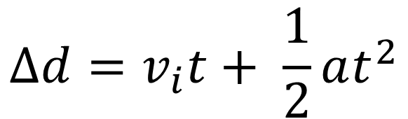
Approach #2
Solve for the distance during constant acceleration using:
$$∆d=v_{i}t+ \frac{1}{2}at^{2}$$
Add this distance to the distance traveled when both the elastic and frictional forces were acting on the phone to get the total distance.

Slide 67


$$∆d=v_{i}t+ \frac{1}{2}at^{2}= \left(1.18 m/s\right)\left(0.576 s\right)+ \frac{1}{2} \left(−2.0 \frac{m}{s^{2}}\right){\left(0.576 s\right)}^{2}=0.348 m$$
$$∆d=0.35 m$$
$$∆d=0.64 m$$
Notes:
The distance traveled during constant acceleration is calculated to be 0.35 m using this approach. In good agreement with the first approach.
The total distance will be the sum of the distance traveled at constant velocity plus the distance traveled while the elastic force and the frictional force were acting on the phone. (0.35 m + 0.29 m)

Slide 68
Experiment 2

Slide 69
Experiment 2
Investigate the relationship between mass and μ_{k}
  Conduct identical experiment with approximately double the mass.
    Calculate the coefficient of kinetic friction and compare to previous data.
    What conclusions can you draw from your measurement?
Notes:
This can be done by placing a second phone on top of the other or placing some other similar mass on the phone. Make sure the connection is secure and the two phones move as one without significant wobbling between the two masses.

Slide 70
Double the Sliding Mass
Notes:
The increase in mass does not have to be exact. The goal is to show that a “significant” change in mass does not significantly change the coefficient of kinetic friction.

Slide 71
Example Data and Calculations

Slide 72
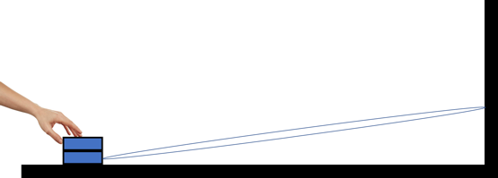
Double the Sliding Mass
Note: The elastic potential energy was increased to provide a similar maximum velocity.
Notes:
The phone was pulled back further to increase the elastic force and therefore allow similar acceleration of the increased mass which in turn produced similar velocity.
The curious student could investigate the coefficient of friction as a function of velocity. Although friction is generally assumed to have a low functional dependence on velocity, this experimental design could allow students to observe measurable changes in the coefficient of friction with velocity for various conditions.

Slide 73
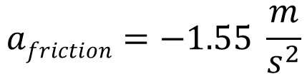
Double the Sliding Mass

Slide 74


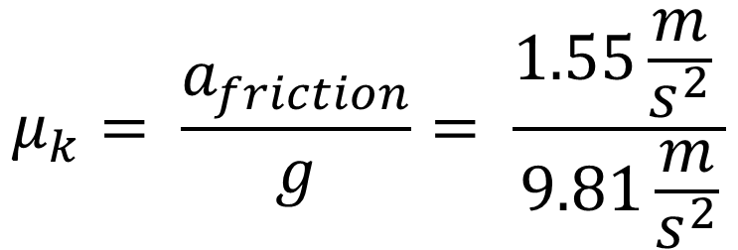

Calculation of the Coefficient of Kinetic Friction - μ_{k}

Slide 75

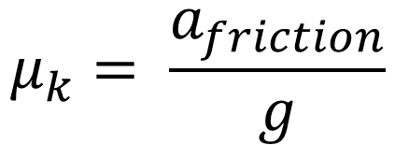


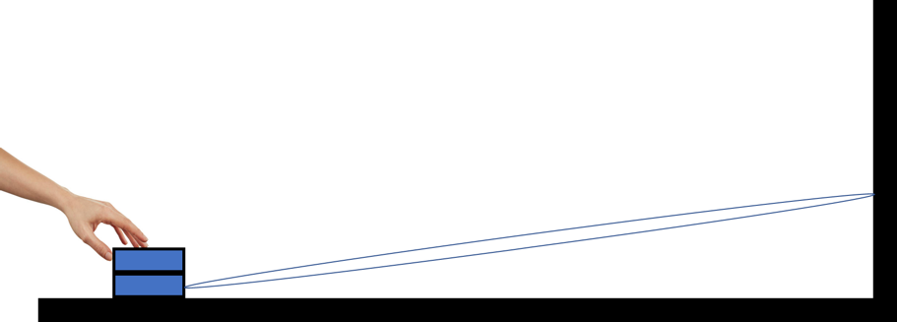
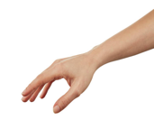
The Coefficient of Friction
Independent of Mass
Notes:
These values are in “good” agreement for demonstrating basic concepts. Students recognize that being the same within 10% is a useful validation of the assumption that the frictional force is nearly independent of mass. The independence of the coefficient of friction with mass will break down as more detailed physics is included in the analysis and the scientist or engineer is interested in variations at the few percent level. For many estimates of understanding work and energy requirements, this will provide a good assumption.

Slide 76
Preliminary data is shown on the next slide. Teachers and advanced students may want to further explore making this type of measurement.
Coefficient of Friction vs Surface Area
Topic for Further Investigation

Slide 77
Investigation of the Dependence of Kinetic Friction on Surface Area
Very reproducible for 2 trials
Slight variations in the acceleration vs time plots
Notes:
In this experiment, a phone was firmly attached to two rigid plates that had the same mass but different surface areas in contact with the desk on which they were sliding. This data shows that doubling the surface area does not significantly impact the coefficient of kinetic friction. The reproducibility for repeated experiments is very good. While the differences with surface area are small, there is some measurable variation when surface area is double. It is left to the individual teachers to determine if this will be helpful or create confusion for students.

Slide 78
Experiment 3

Slide 79
Experiment 3
Investigating changes in μ_{k} for different surface combinations
  First conduct 3 trials for one condition and determine the precision of your measurement.
    Estimate the precision of your measurement?
  Make measurements on 3 different surface combinations.
    Calculate μ_{k} for each surface combination
    Discuss your findings and compare to your measurements to those
    in other groups.
Notes:
Now that students have perfected the experimental method, they are ready to observe variations in the coefficient of friction for different surface combinations. Different groups may already be able to share this information with each other.

Slide 80
Example Data and Calculations

Slide 81
Reproducibility for 4 Repeated Experiments
Total Displacement = 40 cm
Notes:
Reproducibility between experiments is look very good. Expanding graph or numerical analysis is necessary to estimate the precision.

Slide 82
Reproducibility for 4 Repeated Experiments
Estimate precision ~ ± 0.1 m/s²
Notes:
The reproducibility should allow differentiation of acceleration due to friction that vary by 0.2 m/s² .

Slide 83


Dry vs Wet Surface
Wet Surface
Dry Surface
Statistically significant reduction in acceleration on wet surface.
Notes:
This shows data for a wetted surface. The surface was wetted by wiping a wet paper towel over the surface. There is a measurable decrease in acceleration due to friction on the wet surface. This is also apparent by observing the longer “slide” time when all other conditions were held constant.
It is interesting to note the initial slope of the acceleration when the phone is release has a slower rise time. This was reproducible for the experimental conditions. Why might this be the case?

Slide 84
Dry vs Wet Surface
Wet Surface
Dry Surface
Statistically significant reduction in acceleration on wet surface.
Notes:
This shows data for a wetted surface. The surface was wetted by wiping a wet paper towel over the surface. There is a measurable decrease in acceleration due to friction on the wet surface. This is also apparent by observing the longer “slide” time when all other conditions were held constant.
It is interesting to note the initial slope of the acceleration when the phone is release has a slower rise time. This was reproducible for the experimental conditions. Why might this be the case?

Slide 85
Determining Kinetic Friction for Different Surface Combinations
Notes:
This data was collected for a range of different surface combinations. The large variation in frictional forces was very apparent in the experiment. The elastic force applied in for the experiments on glass made use of a rubber band change where the each “link” in the chain was made by two rubber bands. The remaining experiments were made with a chain of singe rubber bands.
Note that this data was taken with a different orientation of the phone, so the curves are reversed.

Slide 86
Kinetic Friction for Different Surface Combinations
Material 1 | Material 2 | Acceleration from Friction (m/s²) | Coefficient of Kinetic Friction
Cardboard | Glass | 5.4 | 0.55
Hard Plastic Case | Glass | 4.8 | 0.49
Aluminum Foil | Glass | 3.2 | 0.33
Aluminum Foil | Polished Wood | 2.3 | 0.23
Aluminum Foil | Aluminum Pan | 2.0 | 0.20
Cardboard | Polished Wood | 1.8 | 0.18
Hard Plastic Case | Polished Wood | 1.5 | 0.15
Ice | Polished Wood | 0.6 | 0.06
Notes:
This data shows the very large variation in coefficient of kinetic friction for a number of surface combinations.
It is particularly interesting to note the large amount of friction that results from glass surfaces. Given that glass surfaces appear to be very smooth, this provides a clear indication that surface roughness must not be the only factor involved in producing friction. This observation can enable a discussion of the effect of molecular level forces that can become important for smooth surfaces.
The very low friction of “ice” allows the discussion of the thin layer of water that is at the interface between the wood and the solid ice. This allows students to get a sense for the much lower friction associated with fluids relative to solid materials. The basis for lubrication.

Slide 87
Experiment 4

Slide 88
Experiment 4
Measurement of Static Friction
  Attach a rubber band chain to your phone. Holding the opposite end of the rubber band chain with your fingers, slowly increase the elastic force applied to the phone. When the elastic force exceeds the maximum force of static friction, the phone will accelerate for a short time before coming back to rest. Measure the acceleration for 4-6 of these events.
    Draw free body diagrams for two different times where values of the
    elastic force is different, but the phone remains stationary
    Draw a free-body diagram for the time immediately after the phone begins
    to move
    How does the elastic force just before the phone begins to move compare to the elastic force immediately after the phone begins to move?
  Measure the coefficient of kinetic friction for the same surfaces.
  Using the maximum value of acceleration from part 1 and the coefficient of kinetic friction from part 2, calculate the coefficient of static friction.
Notes:
Maintain a small an angle between the rubber band the direction of acceleration to assure that the elastic force is directed perpendicular to the normal force on the phone.

Slide 89
Example Data and Calculations

Slide 90


Measurement to Determine Static Friction
1
2
3
1
2
3
Notes:
Measurement of the acceleration of a phone in a hard plastic Otterbox on a varnished wooden board: A rubber band, attached to the phone, was stretched very slowly until the elastic force exceeded the force of static friction. At this time, the phone accelerates because the elastic force is greater than the force from kinetic friction. The constant negative acceleration due to kinetic friction eventually results in the phone coming to rest.
This experiment is similar to experiments on an incline plane where the force on the phone continues to increase as the angle of the incline plane is changed. I would be interesting to compare results from the two types of experiments.

Slide 91
Measurement to Determine Static Friction
F_{normal}
F_{StaticFriction}
F_{elastic}
F_{gravity}
The force of static friction increases to equal the increasing elastic force.

Slide 92
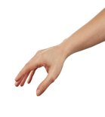
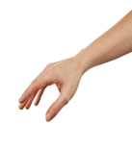
F_{normal}
a = 0
F_{StaticFriction}
F_{elastic}
F_{gravity}
F_{normal}
a = 0
F_{StaticFriction}
F_{elastic}
F_{gravity}
F_{normal}
F_{KineticFriction}
F_{elastic}
a > 0
F_{gravity}
Notes:
As the rubber band is stretched, the force of static friction increases to match the elastic force. This will continue until the elastic force exceeds the maximum force of static friction. At this point, the phone begins to move and the force from dynamic friction is now opposing the larger elastic force. The unequal forces results in acceleration of the phone.

Slide 93
Measurement to Determine Static Friction
4 Replicate Measurements
Notes:
The data shows 4 repeated experiments. The variation of the values could result from variations in the surfaces and real variations in the kinetic friction or it could be due to experimental errors in varying the elastic force at a slow and consistent rate (e.g., if the experimenter continued to stretch the rubber band after the phone began to move, it would result in additional elastic force). Over a series of testing, the most likely source of variation is variations in the force from static friction associated with small variations in the surfaces.

Slide 94
F_{normal}
F_{normal}
a = 0
a = a_{max}
F_{StaticFriction}
F_{elastic}
F_{KineticFriction}
F_{elastic}
F_{gravity}
F_{gravity}
Notes:
Illustration of the transition from stationary to moving. The force from static friction is opposing the elastic force when the phone is stationary. Kinetic friction is opposing the elastic force when the phone is moving (accelerating in this case).

Slide 95
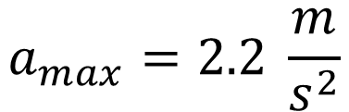
Notes:
Determine average maximum value of the acceleration when the phone begins to move.
The data shows 4 repeated experiments. The variation of the values could result from variations in the surfaces and real variations in the kinetic friction or it could be due to experimental errors in varying the elastic force at a slow and consistent rate. Over a series of testing, the most likely source of variation is variations in the force from static friction associated with small variations in the surfaces.

Slide 96

Measure Coefficient of Kinetic Friction
This is needed for the calculation of static friction
a_{KineticFriction} = -1.9 m/s²
Notes:
Calculating the static friction requires the measurement of the kinetic friction. This is measured in a similar fashion as in previous activities for the two surfaces used in this experiment.

Slide 97






Begin with Newton’s second law
Notes:
Calculation of the coefficient of static friction.
Use Newton’s second law and the equations for static and kinetic friction.
Use experimental value for the coefficient of kinetic friction and the maximum value of acceleration just after movement begins.
Make assumption that the magnitude of the elastic force just before movement and just after movement does not change significantly.

Slide 98
Experiment 5

Slide 99
Experiment 5
Consider New Experimental Designs
  Working with your classmates, discuss alternative ideas for measuring kinetic or static friction using the accelerometer sensor.
    Test your idea and share your idea with other classmates and teachers.
Notes:
This is a rich experimental space.
Consider using incline planes to use gravitational forces.
Consider other ways to provide initial force.

Slide 100
Example Data and Ideas For Investigation.

Slide 101
Initial acceleration achieve by pushing with hand. Higher initial acceleration resulting
in a longer time for friction to negatively accelerate to a stop.
Notes:
This is an example where the initial force was generated by a push with a hand. It took about 3 tries to get a long slide with minimal rotation. It was interesting to note the shape of the acceleration data as the push began and the phone was released. It was interesting to observe that the release of the phone was not “instantaneous” and that there were several measurements made during the release. (We saw a much faster transition in acceleration when we released the phone when it was connected to the rubber band, so we know the response time is faster than what is shown in this data.)

Slide 102


Student can investigate various experimental designs to measure the kinetic and static friction using incline planes using the accelerometers on their phones.
Notes:
The use of inclines introduces an additional math component (trigonometry) to the analysis. One of the advantages of the initial method was that it allows for the measurements to be done using more conceptual thinking which is not complicated by the need to use trigonometry. That said, friction experiments with inclines can add another layer to the experimental design and analysis.

Slide 103
Pressure in our Lives
How might you change the world with your understanding of friction?

Slide 104

Do you ever have trouble getting all the ketchup out of the bottle?
It would be nice to reduce the friction between the ketchup and the internal bottle surface.

Slide 105

Notes:
Simple application that everyone has experienced.

Slide 106

Magnetically Levitated Trains
Notes:
The elimination of friction allows for faster transport.
It might be interesting to mention the use of regenerative breaking in electric vehicles is another important way to reduce energy losses to friction. The conversion of momentum into electrical potential energy avoids the loss of energy to heat as the brake pads press against the rotors.

Slide 107


Notes:
Nanodiamonds have great potential as future lubricants and are the subject of much research and development. Explain that traditional lubricants in mechanical systems were based on mineral oils. Advances in material science and the ability to make and characterize nanomaterials opens up completely new approaches to reduce friction in the future. Similar work is being done with liquid crystals as the lubricants (students may be familiar with the liquid crystals in many of the electronic displays).
This example application illustrates the cross-cutting science where nanomaterials are used to reduce friction in medical applications that include the dual potential of the nanodiamonds in battling bacterial infection.

Slide 108




Understanding Earthquakes
Notes:
Understanding the static and kinetic friction along faults is extremely important in understanding when earthquakes might occur and how energy is released as the faults slide by each other.

Slide 109


Earthquake Simulation Lab at Cal Tech
A research group at Cal Tech designed an experiment to take high speed video of the movement of an artificial fault under varying amounts of pressure.
Notes:
Teacher can explain:
Before an earthquake, static friction helps hold the two sides of a fault immobile and pressed against each other. During the passage of an earthquake rupture, that friction becomes dynamic as the two sides of the fault grind past one another. Dynamic friction evolves throughout an earthquake, affecting how much and how fast the ground will shake and thus, most importantly, the destructiveness of the earthquake.
Previously, it commonly had been believed that the evolution of dynamic friction was mainly governed by how far the fault slipped at each point as a rupture went by—that is, by the relative distance one side of a fault slides past the other during dynamic sliding. Analyzing earthquakes that were simulated in a lab, the team instead found that sliding history is important, but the key long-term factor is actually the slip velocity—not just how far the fault slips, but how fast.

Slide 110

Hopefully, you will not limit the application
of your knowledge of friction to doing donuts

Slide 111

Let Me
Know
I welcome any feedback on errors you might find or ideas on how to improve this for students and teachers.
Prepared by:
David Rakestraw
Senior Scientist
Lawrence Livermore National Laboratory
rakestraw1@llnl.gov • 925-216-8106 • st.llnl.gov

Slide 112

This work was performed under the auspices of the U.S. Department of Energy by Lawrence Livermore National Laboratory under Contract DE-AC52-07NA27344.

